Slide 1
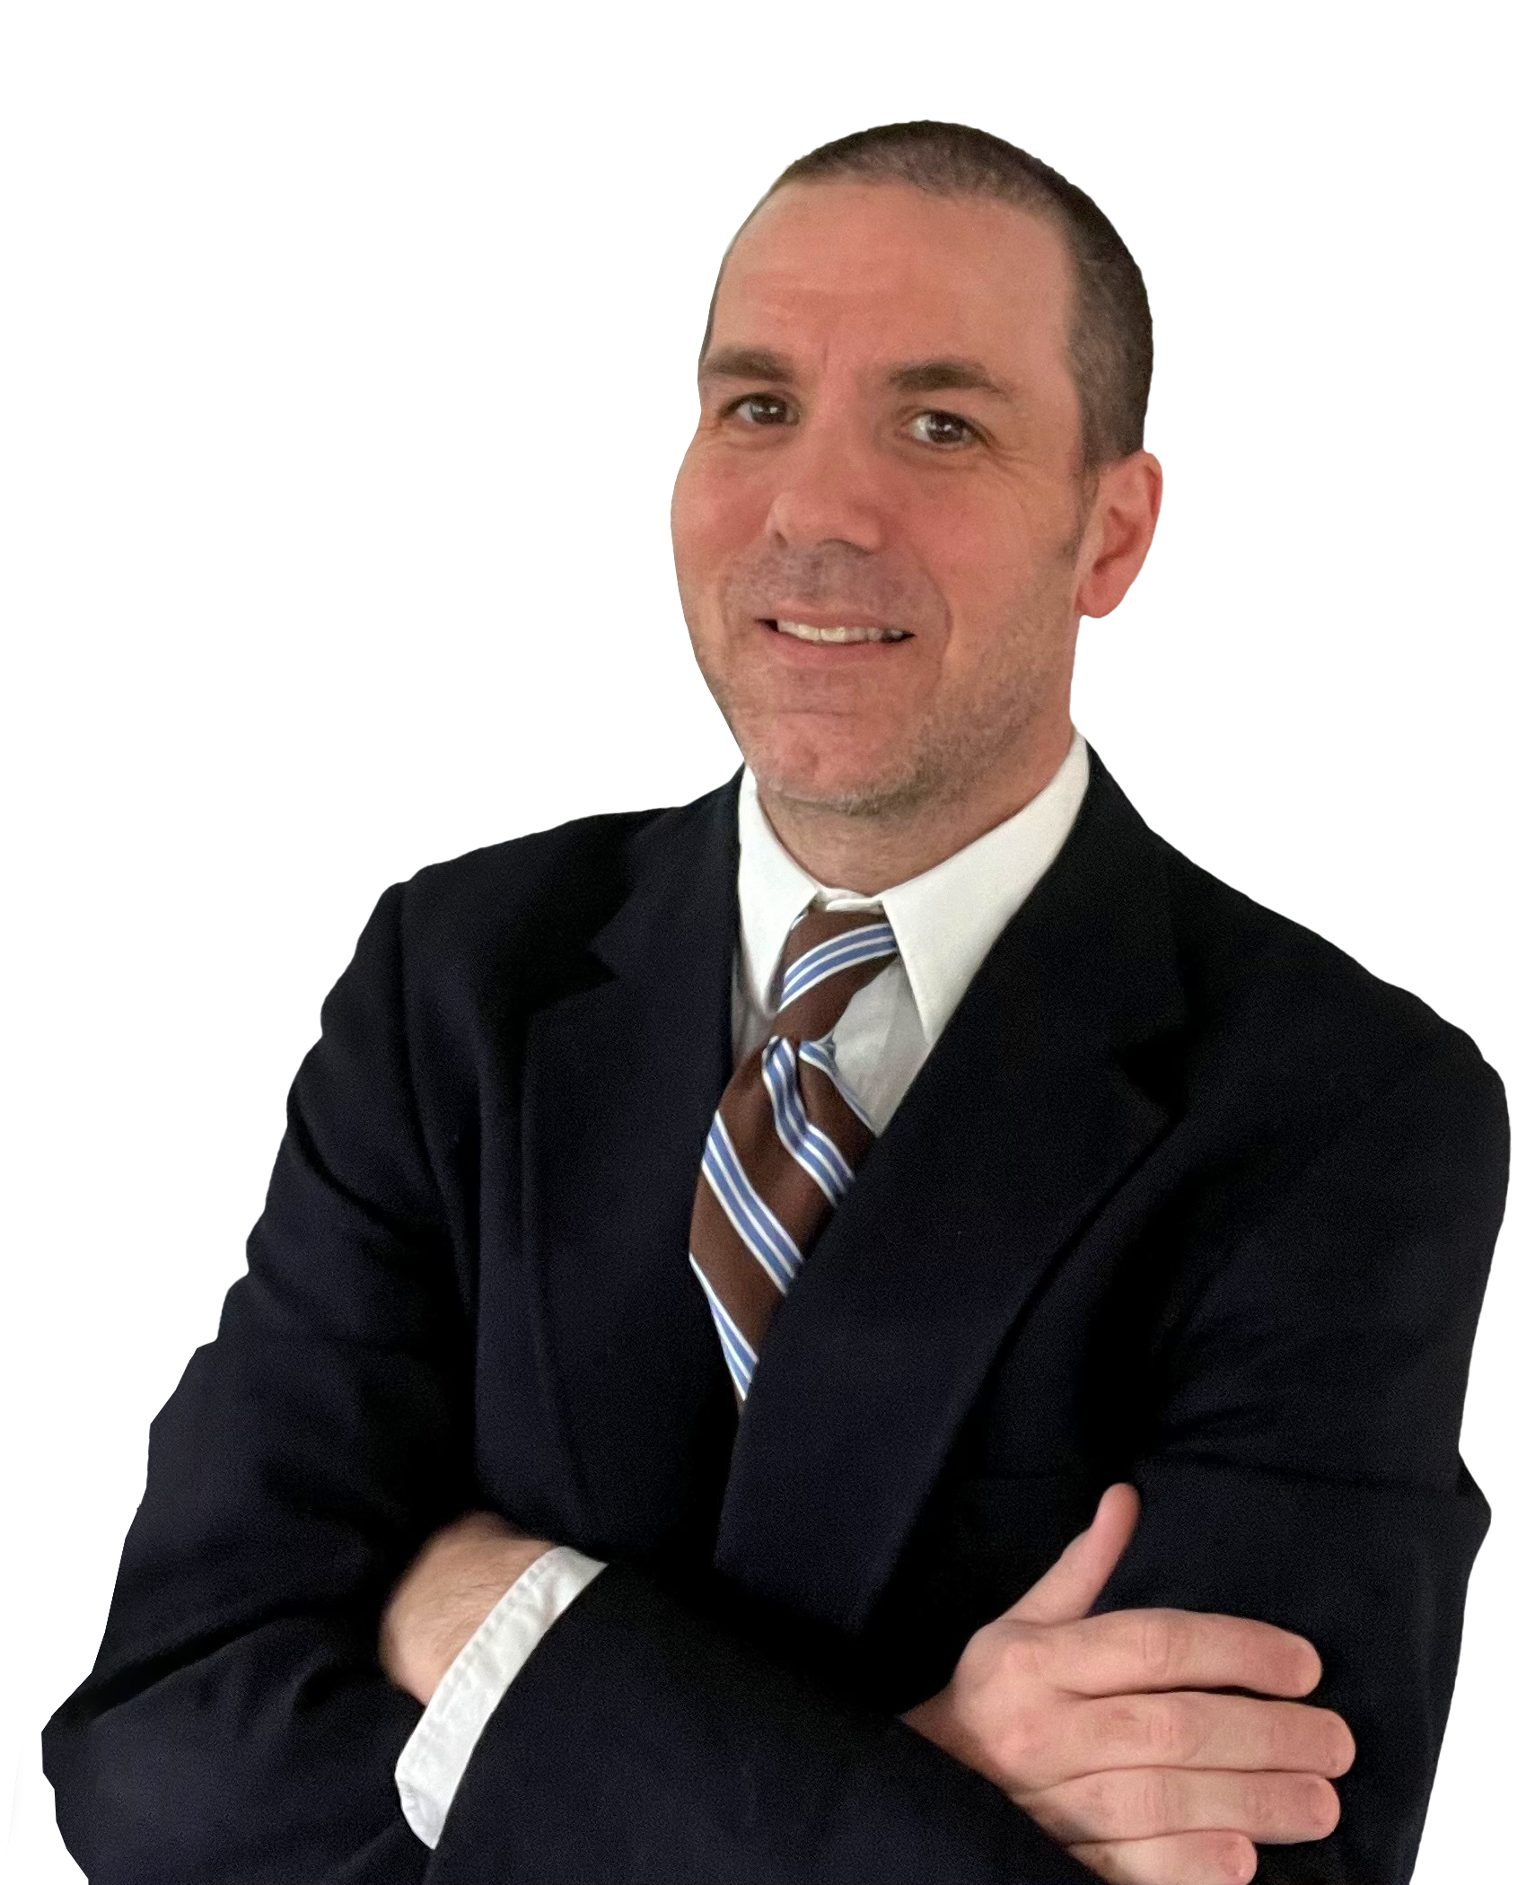
Cabot Options Institute Earnings Trader Subscriber-Exclusive Webinar
Andy Crowder, Chief Options Strategist Cabot Options Institute

Slide 2
Over the Next Hour
Weekly Review
Closed Trades
Open Positions
Potential Trades
Questions and Answers

Slide 3
Weekly Review

Slide 4
Closed Positions

Slide 5
Open Positions

Slide 6
Potential Trades
Notes:
QQQ, XOP, SPY, IWM, DIA, EEM, EFA, XLF

Slide 7
Questions & Answers

Slide 8
Thank You!

