Slide 1
Earnings Trader Subscriber- Exclusive Webinar
Andy Crowder, Chief Options Strategist Cabot Options Institute

Slide 2
Welcome!

Slide 3
Over the Next Hour
Resources
The Strategy
Our Approach
A Few Sample Trades
Real-Time Trades
Questions and Answers

Slide 4
The One Statistical Law All Successful Traders Follow

Slide 5
Coin Toss Example

Slide 6
Variance is a Factor

Slide 7
Maximizing the Number of Trades
If you flip the coin 10 times, 7 heads and 3 tails may occur (70% heads / 30% tails)
If you flip the coin 100 times, 60 heads and 40 tails may occur (60% heads / 30% tails)
If you flip the coin 500 times, 275 heads and 225 tails may occur (55% heads / 45% tails)
If you flip the coin 1,000 times, ~500 heads and ~500 tails may occur (~50% heads / ~50% tails)

Slide 8
My Approach to Earnings Season

Slide 9
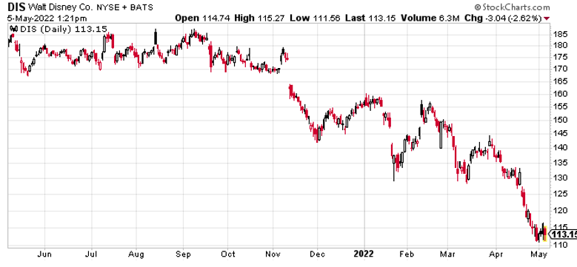
Disney (DIS)

Slide 10
What is the Expected Move?
The expected move is the amount a stock or ETF is predicted to advance or decline from its current share price, based on the security’s current level of implied volatility and days to expiration.
Additionally, the expected move fluctuates, in real time, based on changes in a security’s price and its implied volatility.
Simply stated, the expected move shows us the future expected range of a security over a specific time frame.

Slide 11
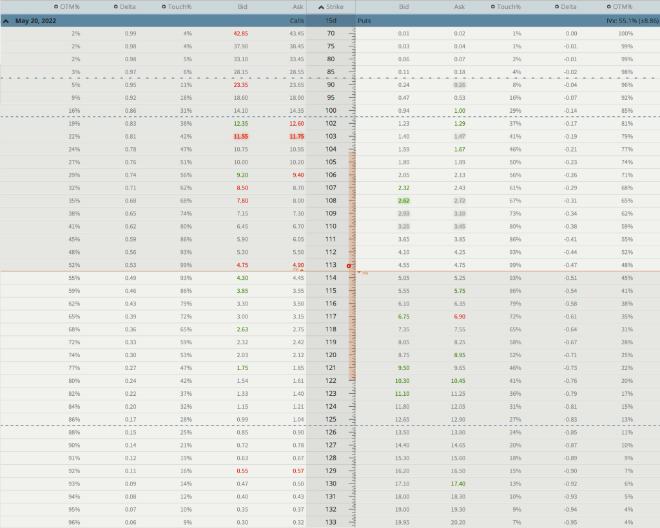
Disney Expected Move
Expected Move – 104 to 122
Range – 18 points

Slide 12
Call Side: Disney Iron Condor

Slide 13
Put Side: Disney Iron Condor

Slide 14
Call Side: DIS 127/132
Put Side: DIS 100/95

Slide 15
The Trade
Simultaneously:
Sell to open DIS May 20, 2022, 127 calls
Buy to open DIS May 20, 2022, 132 calls
Sell to open DIS May 20, 2022, 100 puts
Buy to open DIS May 20, 2022, 95 puts for roughly $0.85 or $85 per iron condor
Our potential return on the trade: 20.5%

Slide 16
Parameters of the Trade
Here are the parameters for this trade:
The Probability of Success – 88.87% (call side) and 83.36% (put side)
The maximum return on the trade is the credit of $0.85, or $85 per iron condor
Breakeven level: 99.15 – 127.85
The maximum loss on the trade is $415 per iron condor. Remember, we always adjust if necessary, and always stick to our stop-loss guidelines. Position size, as always, is key.

Slide 17
Risk Management

Slide 18
Position Size

Slide 19
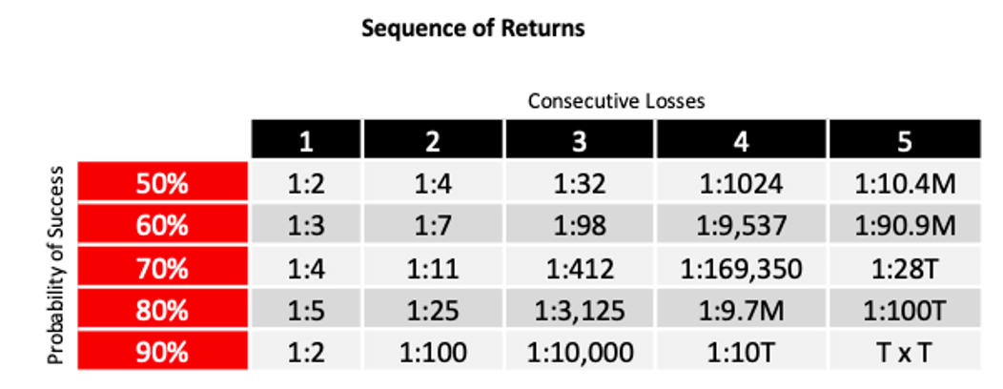
Sequencing Returns

Slide 20
The Importance of Position Size

Slide 21
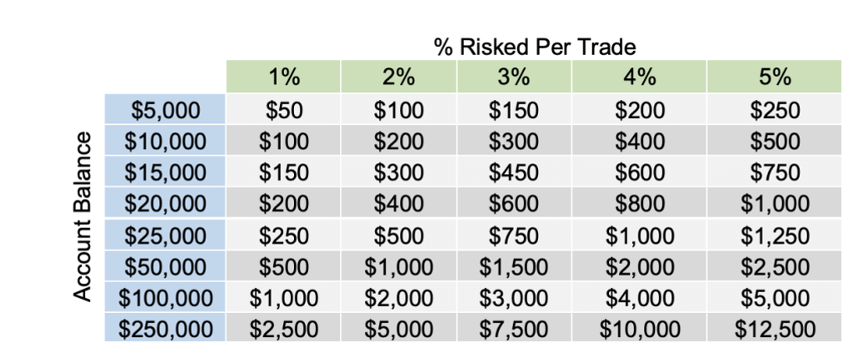
… And the First Step is Proper Position Size.

Slide 22
$10,000 Account (50% allocated per trade):
One position, equally weighted at $5,000. So, with each trade, a 10% drop will cause a 5% drop in our overall portfolio. A 20% drop will cause a 10% drop, 30% would be 15% . . . you get the picture.
Just knowing this gives every options trader the insight necessary to shape a position size and stop-loss strategy for maximum effectiveness.
Let’s say with each trade we set our stop-loss order at 50% of our allocated amount. For example, with 50% allocated to each trade, our stop-loss would be set at $2,500.
Two trades would only allow us to diversify among two positions with 50% of our overall portfolio value at risk.

Slide 23
$10,000 Account (5% allocated per trade):
One position, equally weighted at $500. So, with each trade, a 10% drop will cause a 0.5% drop in our overall portfolio. A 20% drop will cause a 1% drop, 30% would be 1.5% . . . again, you get the picture.
Our stop-loss with 5% allocated per trade is $250.
For example, if we had four iron condor trades open simultaneously, we would have $2,000 in play with only $1,000 or 10% of our overall portfolio at risk.
Worst-Case Scenario
If we assume our position size of $500 per trade and had four trades going at one time, our maximum loss is 10% or $1,000 of our overall portfolio.
A 10% loss in the portfolio would need a 11.11% overall gain to make up for the loss.

Slide 24
Summary

Slide 25
Trading Platform

Slide 26
Questions?

