Slide 1
Rebalancing your Portfolio after Coronavirus
Nancy Zambell, Chief Analyst Wall Street’s Best Investments

Slide 2
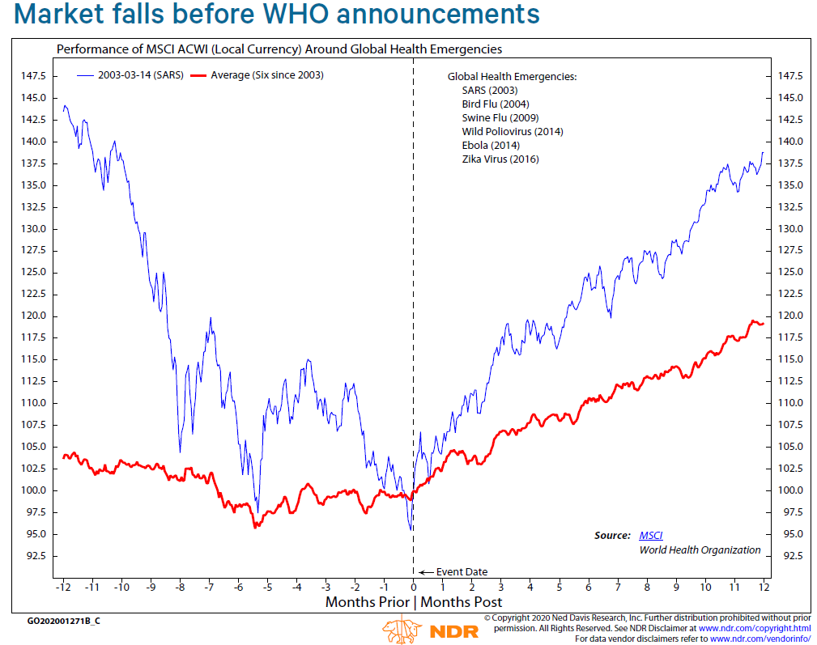
Coronavirus—not our First Rodeo
As you can see from this chart, disease outbreaks normally roil the markets.
But what the chart also shows is these are temporary phenomena.

Slide 3
Historic Medical Events & the Market
EPIDEMIC | MONTH END | 6-MONTH % CHANGE OF S&P | 12-MONTH % CHANGE OF S&P
HIV/AIDS | June 1981 | -0.3 | -16.5
Pneumonic plague | Sept 1994 | 8.2 | 26.3
SARS | April 2003 | 14.59 | 20.76
Avian flu | June 2006 | 11.66 | 18.36
Dengue Fever | Sept 2006 | 6.36 | 14.29
Swine flu | April 2009 | 18.72 | 35.96
Cholera | Nov 2010 | 13.95 | 5.63
MERS | May 2013 | 10.74 | 17.96
Ebola | March 2014 | 5.34 | 10.44
Measles/Rubeola | Dec 2014 | 0.20 | -0.73
Zika | Jan 2016 | 12.03 | 17.45
Measles/Rubeola | June 2019 | 9.82% | N/A
—Source: Dow Jones Market Data

Slide 4
It’s Time to Buy, not Sell!
“The time to buy is when there is blood in the streets.” - Baron Rothschild
“Trading stocks in this kind of market can be a crap shoot, as it’s panic selling, which rarely works out well for the individual investor.” - Nancy Zambell

Slide 5
However, there may be some reasons to Sell
Some of these failing indicators would be:
Were they losing money before the outbreak?
Are they overloaded with debt?
Were revenues shrinking before coronavirus?
Are they in a sector that was suffering before the pandemic?

Slide 6
The Last 3 Selling Tests
Are all the reasons I originally bought this stock still in place?
Is my price target still valid?
Can I make more money by retaining the stock than by substituting another investment?

Slide 7
Reevaluate and Rebalance A cyclical economy

Slide 8
Know your Investing Profile
Here’s a link to your Investing Profile survey:
https://cabotwealth.com/daily/how-to-invest/investor-profile-survey/

Slide 9
Allocate your Portfolio according to your Risk Tolerance
Source: Schwab Center for Financial Research

Slide 10
Your Age may Matter
The Old School of Thought

Slide 11
The New School of Thought

Slide 12
Sample Age-Related Portfolios
Source: Schwab Center for Financial Research

Slide 13
Evaluating: Start with a List
List your holdings by cash, bonds, mutual funds, and stocks. Next, industry/sector, market cap, U.S., emerging market, international, style: growth, value, growth and income, 3-year, 5-year, 1-year, and year-to-date returns (those will soon change for the better!), and what percentage of your portfolio that particular position holds.
For your mutual funds and ETFs, write down the names of the companies—and how much of each the fund holds, as well as their investing style/strategy.

Slide 14
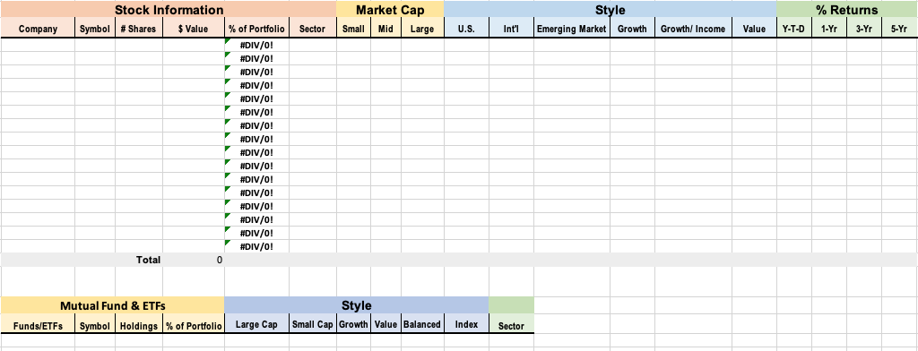
Sample Spreadsheet
Download the spreadsheet at CabotWealth.com/InvestorWorksheet

Slide 15
Reallocate with Sectors likely to Outperform
Best- and Worst-Performing Sectors
The Best
Sector Year-to-Date Return
Technology 5.0%
Healthcare -0.1%
Consumer Disc. 4.0%
The Worst
Sector Year-to-Date Return
Energy -33.7%
Financial Services -27.5%
Industrials -21.6%

Slide 16
Sectors for a Bull Market
During a bull market, sectors that often fare very well are:
Transportation. I think we will certainly see the airlines and trucking companies, even railroads, spring back once the pandemic is on the downside of the curve.
Financial. These companies may take a little longer. They struggled for a while in the previous bull market and had just found their feet when the virus struck. However, there will be some—especially the asset managers—who should fare very well with a new bull market.
Technology. Certainly, there will be a lot of spending, as companies have tightened their belts right now. So, look for some exceptional growth in this arena.
Capital Goods. Just like with tech companies, demand is pent up, and once released, these stocks should do well.

Slide 17
Growth Idea
Growth Idea:
Company | Symbol | Price $ | Style | Industry/Sector | Analyst Ranking
Sea Limited | SE | 69.49 | Large Cap | Electronic Gaming | 1.5

Slide 18
Growth & Income Idea
Company | Symbol | Price $ | Style | Industry/Sector | Dividend Yield % | Analyst Ranking
Microsoft Corporation | MSFT | 184.91 | International | Software | 1.22 | 1.7

Slide 19
Value Idea
Company | Symbol | Price $ | Style | Industry/Sector | Analyst Ranking
21 Vianet Group, Inc. | VNET | 16.85 | mall Cap | Info Technology | 1.3

Slide 20
Speculative Idea
Company | Symbol | Price $ | Industry/Sector | Analyst Ranking
Moderna, Inc. | MRNA | 80.00 | Biotechnology | 2.0

Slide 21
Special Webinar Introductory Deal: A private invitation to receive $20k worth of published investing research for $1
Every week Nancy Zambell scours more than 200 advisories and research reports to select the top recommendations by the top analysts. Selections run the full range of stock opportunities. Don’t miss out. Subscribe today!
Monthly issues with the latest recommendations and updates on the hottest stocks
Daily trading alerts when the market opens so you’re kept in The Know
24/7 online access to exclusive subscriber website
Direct access to Chief Analyst Nancy Zambell for answers to your questions.
Offer Available to New Subscribers Only: CabotWealth.com/webinarspecial

Slide 22
Questions
Please submit questions using the chat feature.
Upcoming Event
[FREE Webinar] The American Income Crisis + 2 High-Yield Stocks to Buy Tom Hutchinson, Chief Analyst, Cabot Dividend Investor
Tuesday, June 16 at 2:00 PM ET Sign up now at CabotWealth.com/webinars

Slide 23
Contact
Nancy Zambell
Chief Analyst
Wall Street’s Best Investments
Support@CabotWealth.com

