Slide 1
Cabot Options Institute Income Trader Live Analyst Briefing with Q&A
Andy Crowder, Chief Options Strategist Cabot Options Institute

Slide 2
Welcome!

Slide 3
Over the Next Hour
Subscriber Page - Resources
The Strategies
Trading Platform – Live
Current Positions
Questions and Answers

Slide 4
Selling Puts
Income Wheel Strategy
Covered Strangle
Jade Lizards

Slide 5
Selling Puts in VanEck Miners ETF (GDX)

Slide 6
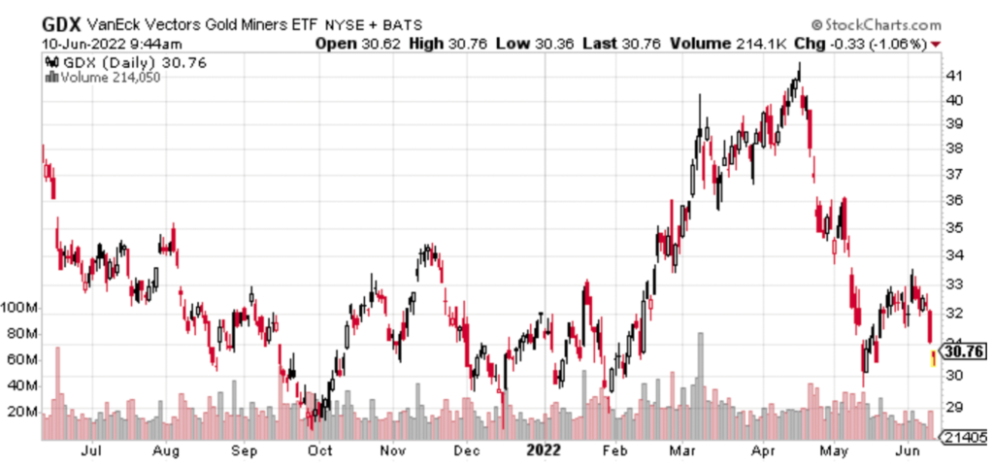
VanEck Gold Miners ETF (GDX)

Slide 7
IV Rank
IV rank simply tells us whether implied volatility is high or low in a specific underlying based on the past year of IV data.
IV: 38.8% IV Rank: 96.0 (current)

Slide 8
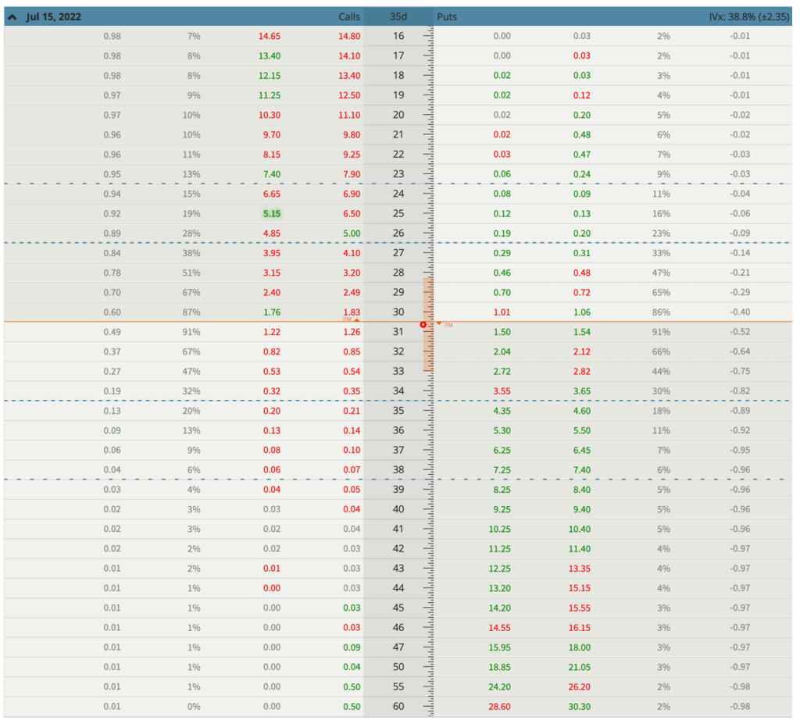
Expected Move

Slide 9
Expected Move
Expected Move (Range): The expected move (range) for the July 15, 2022 expiration cycle is from 28.50 to 33.

Slide 10
Selling Puts
June 10, 2022
With GDX trading for 30.76 I want to sell puts at the 29 put strike going out 35 days for roughly $0.66, if not higher.

Slide 11
Selling Puts
The Trade
Sell to open GDX July 15, 2022, 29 put strike for a total of $0.66 or higher (As always, prices will vary, please adjust accordingly.)

Slide 12
Selling Puts
Delta of short put: 0.28 Probability of Profit: 67.54% Probability of Touch: 62.30% Total net credit: $0.66 Max return (cash-secured): 2.3%

Slide 13
What’s Next?

Slide 14
Risk Management

Slide 15
Trading Platform

Slide 16
Questions?

Slide 17
Contact
Andy Crowder, Chief Options Strategist
Cabot Options Institute Masters Club
Cabot Options Institute Fundamentals
Cabot Options Institute Quant Trader
Cabot Options Institute Income Trader
Cabot Options Institute Earnings Trader
andy@CabotWealth.com

