Slide 1
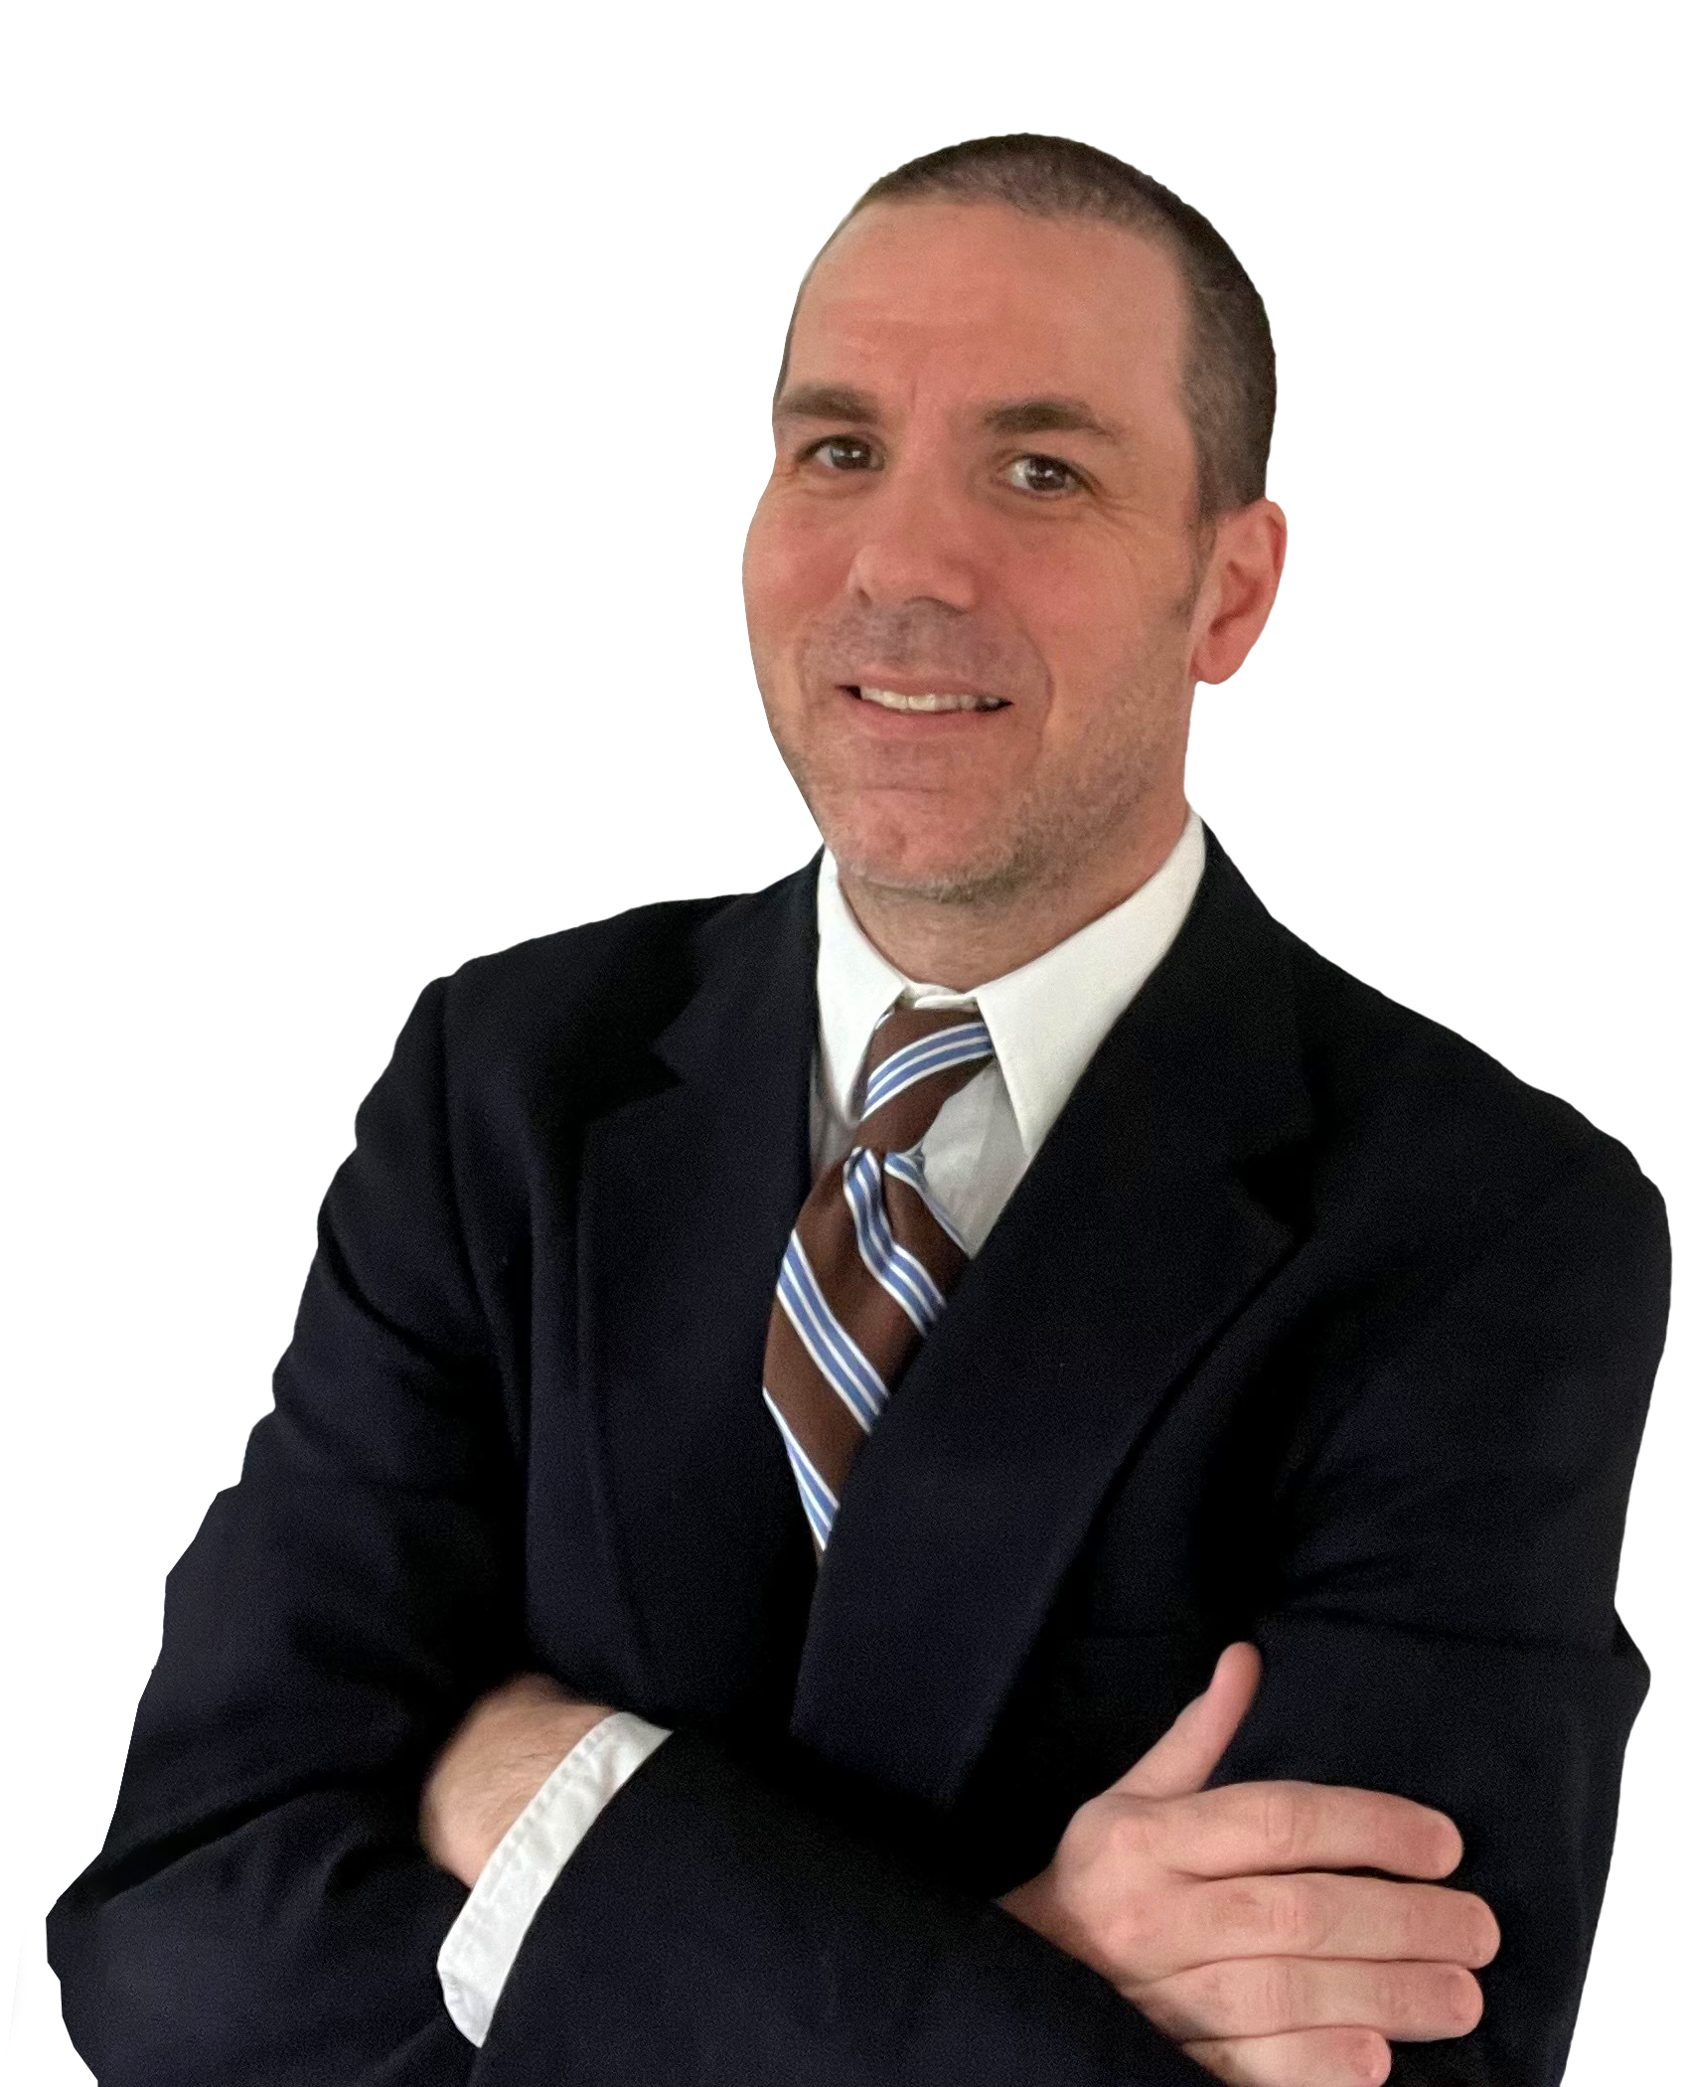
Cabot Options Institute Quant Trader Live Analyst Briefing with Q&A
Andy Crowder, Chief Options Strategist Cabot Options Institute

Slide 2
Welcome!

Slide 3
Over the Next Hour
Subscriber Page - Resources
The Strategies
Trading Platform – Live
Current Positions
Questions and Answers

Slide 4
Bear Call Spread
Bull Put Spread
Iron Condor

Slide 5
Bear Call Spread in SPY

Slide 6
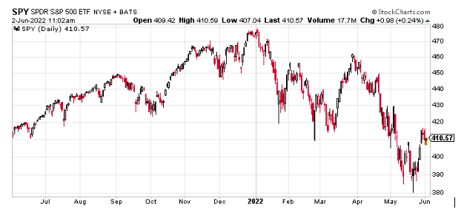
SPDR S&P 500 ETF (SPY)

Slide 7
IV Rank
IV rank simply tells us whether implied volatility is high or low in a specific underlying based on the past year of IV data.
IV: 26.56% IV Rank: 82.47

Slide 8
Expected Move
Expected Move (Range): The expected move (range) for the July 15, 2022 expiration cycle is from 387 to 436.

Slide 9
Bear Call Spread
June 2, 2022
With the S&P 500 (SPY) trading for 410.57 I want to place a short-term bear call spread going out 43 days. My intent is to take off the trade well before the July 15, 2022 expiration date.

Slide 10
Bear Call Spread
Simultaneously:
Sell to Open SPY July 15, 2022 440 call strike Buy to Open SPY July 15, 2022 445 call strike for a total of $0.70 (As always, the price of spread will vary, please adjust accordingly.)

Slide 11
Bear Call Spread
Delta of spread: 0.05 Probability of Profit: 86.56% Probability of Touch: 27.47 Total net credit: $0.70 Total risk per spread: $4.30 Max return: 16.3%

Slide 12
Risk Management

Slide 13
Trading Platform

Slide 14
Questions?

Slide 15
Contact
Andy Crowder, Chief Options Strategist
Cabot Options Institute Masters Club
Cabot Options Institute Fundamentals
Cabot Options Institute Quant Trader
Cabot Options Institute Income Trader
Cabot Options Institute Earnings Trader
andy@CabotWealth.com

