Slide 1

Why this Market is Perfect for 3 Specific Option Trades
(Giving you a chance at 15% gains in 30 days)
Andy Crowder, Chief Analyst
Crowder Options

Slide 2
Welcome!

Slide 3
Over the Next Hour
The New Bull Market
The Foundation Behind the Approach
The Three Main Strategies
Questions and Answers
Real-Time Trades

Slide 4
The New Bull Market

Slide 5
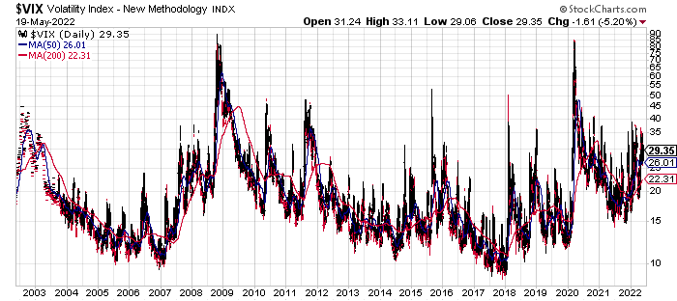
The New Bull Market is in Volatility

Slide 6
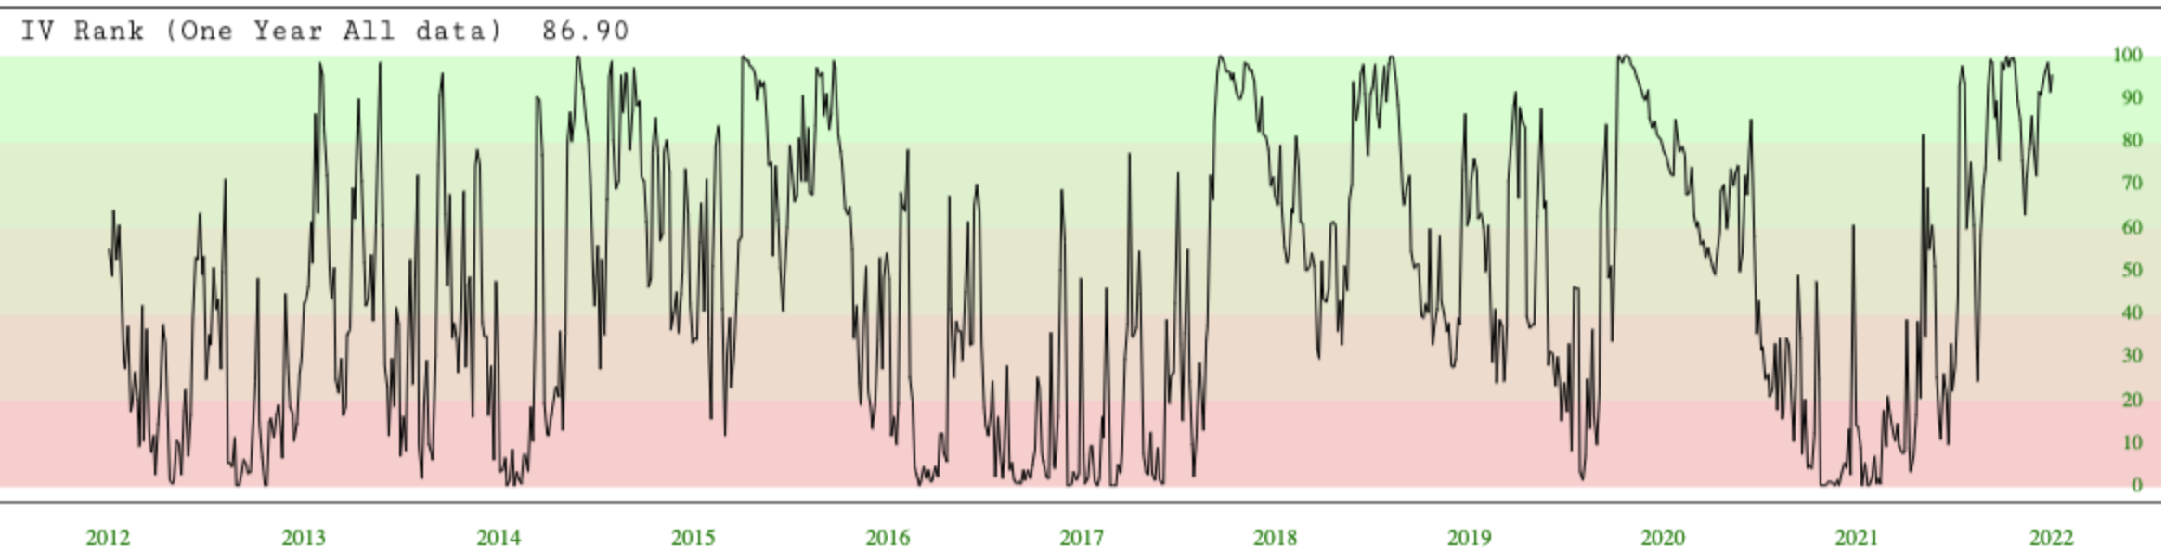
What Volatility is Telling Us

Slide 7
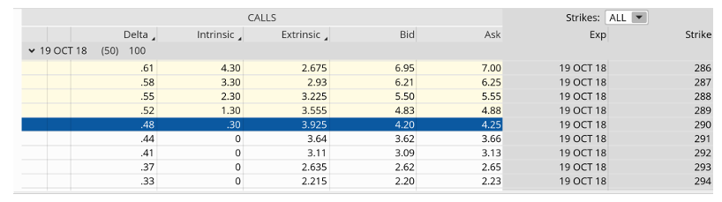
Premium in a Low Volatility Environment
August 30, 2018
The VIX was 13.53 at the time. SPY was trading for 290.30.

Slide 8
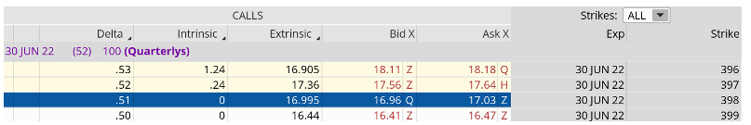
Premium in a High Volatility Environment
May 9, 2022
The VIX is trading for 35.01, close to three times as high as the previous slide. SPY is trading for roughly 398.

Slide 9
Casino or Guests?

Slide 10
Become the Casino

Slide 11
Industries Built on Probabilities

Slide 12
The Simple Bell Curve

Slide 13
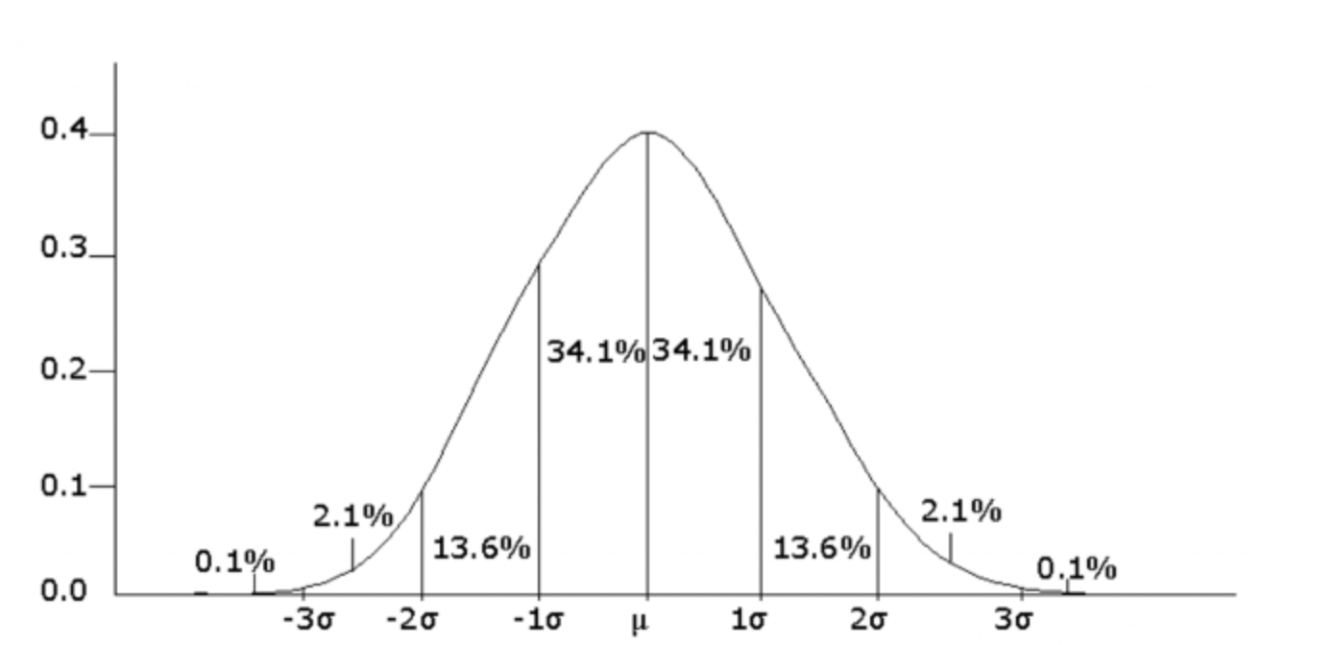

Slide 14
The Importance of Probabilities

Slide 15
A New Approach to Investing

Slide 16
The Foundation of Taking a Statistical Approach to Options Trading

Slide 17
“In Investing, It’s When You Start and When You Finish”

Slide 18
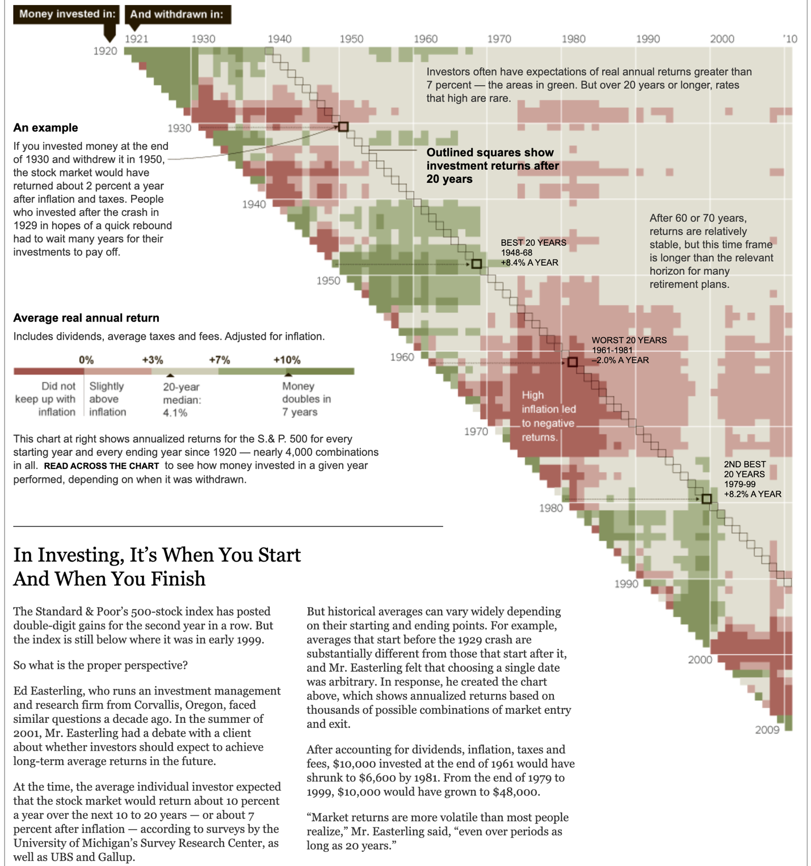
Source: Crestmont Research: The New York Times

Slide 19
Basically, Markets Are Unpredictable?

Slide 20

There is No Crystal Ball!

Slide 21
Strategies that Allow Us to Make Money in Any Type of Market:
Bullish, Bearish or Sideways

Slide 22
This is Why I Use Options

Slide 23
The One Statistical Law All Successful Traders Follow

Slide 24
The Law of Large Numbers states:
As you increase your sample size, in our case number of trades, the expected value or probability of success will come to fruition.

Slide 25
Variance Is a Factor

Slide 26
If you flip the coin 10 times, 7 heads and 3 tails may occur (70% heads / 30% tails)
If you flip the coin 100 times, 60 heads and 40 tails may occur (60% heads / 30% tails)
If you flip the coin 500 times, 275 heads and 225 tails may occur (55% heads / 45% tails)
If you flip the coin 1,000 times, ~500 heads and ~500 tails may occur (~50% heads / ~50% tails)

Slide 27
My Approach to Options Trading

Slide 28
The Three Main Strategies

Slide 29
Strategies that Allow for Any
Account Size

Slide 30
Bear Call Spread

Slide 31
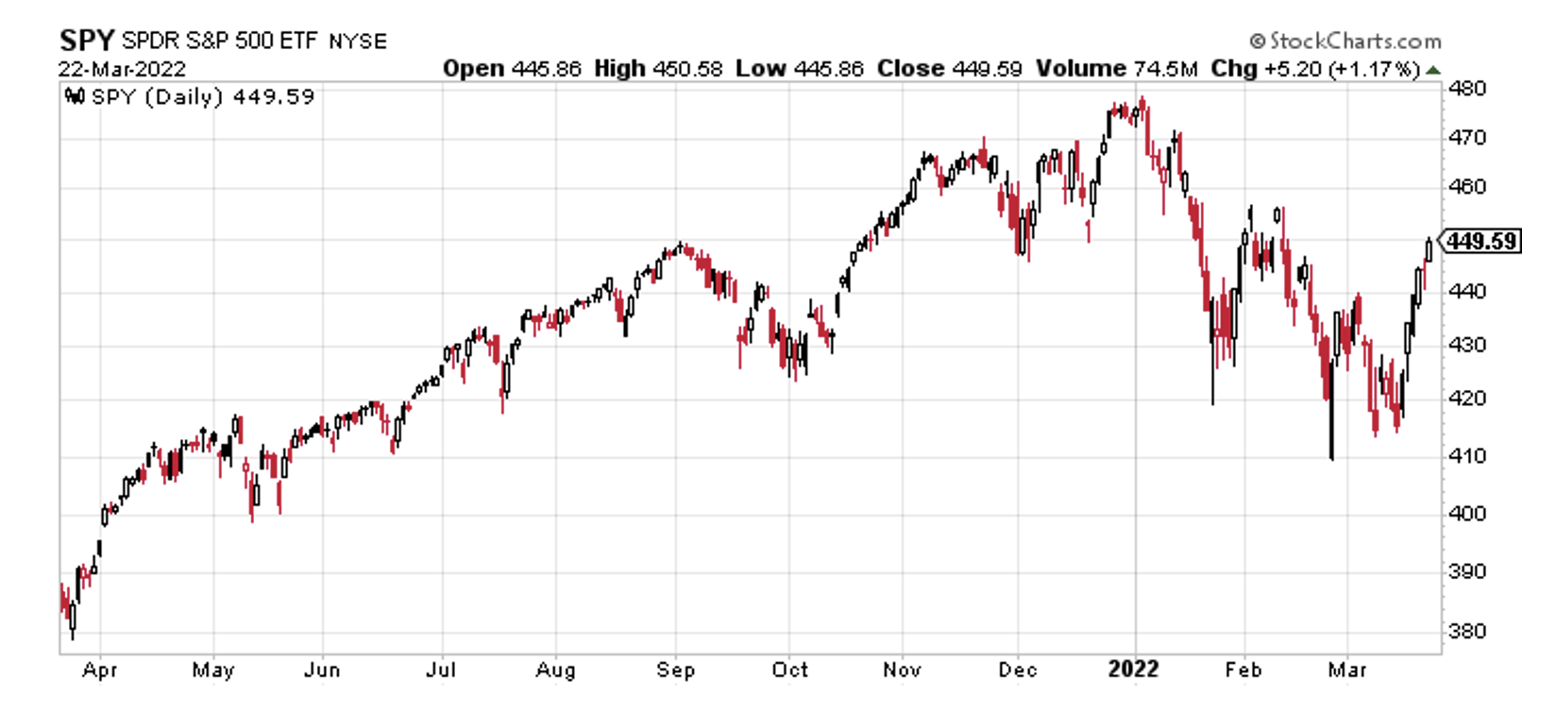
Bear Call Spread

Slide 32
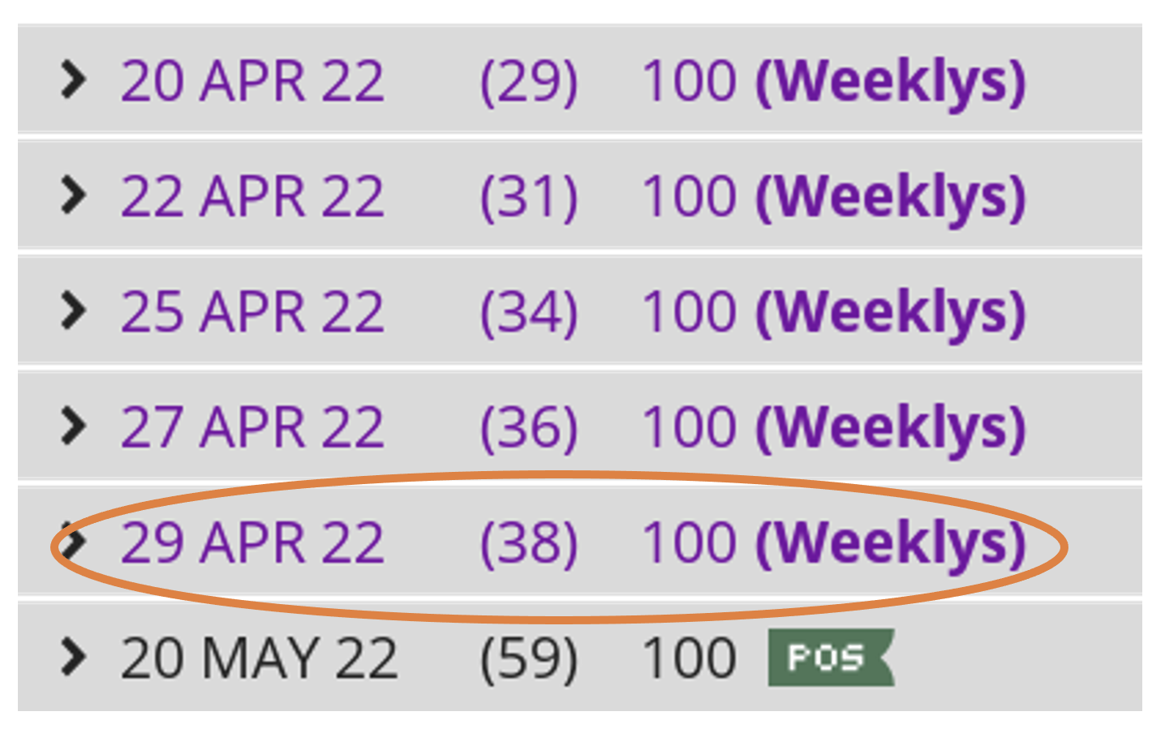
Bear Call Spread

Slide 33
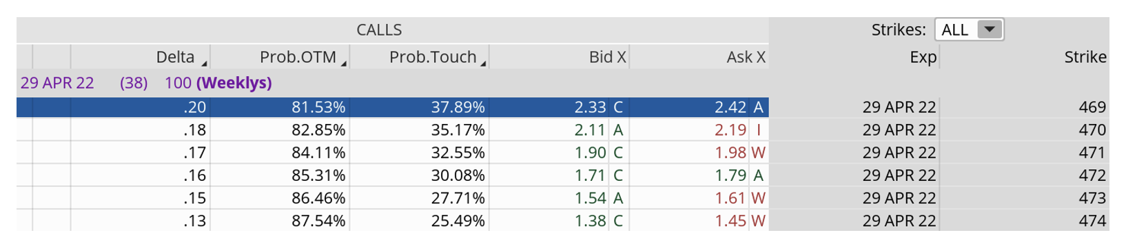
Bear Call Spread

Slide 34
The Trade: 469/474 Bear Call Spread
Simultaneously:
Sell to open SPY April 29, 2022, 469 strike
Buy to open SPY April 29, 2022, 474 strike for a total net credit of roughly $0.95 or $95 per bear call spread
Probability of Success: 81.53%
Total net credit: $0.95, or $95 per bear call spread
Total risk per spread: $4.05, or $405 per bear call spread
Max Potential Return: 23.5%

Slide 35
Risk Management

Slide 36
Bull Put Spread

Slide 37
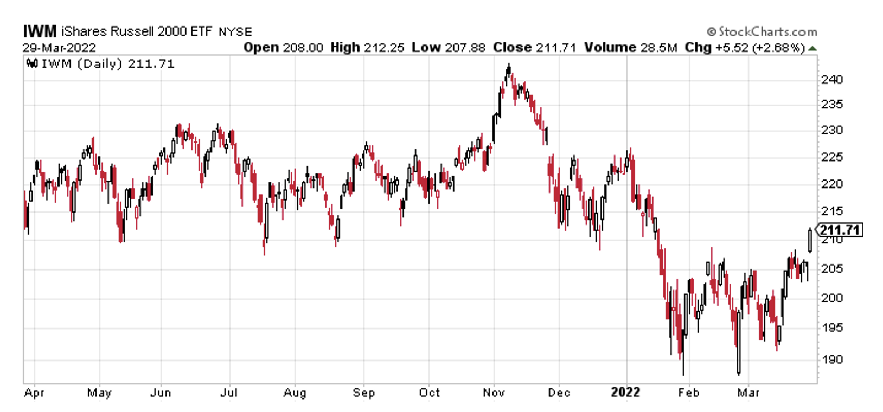

Slide 38
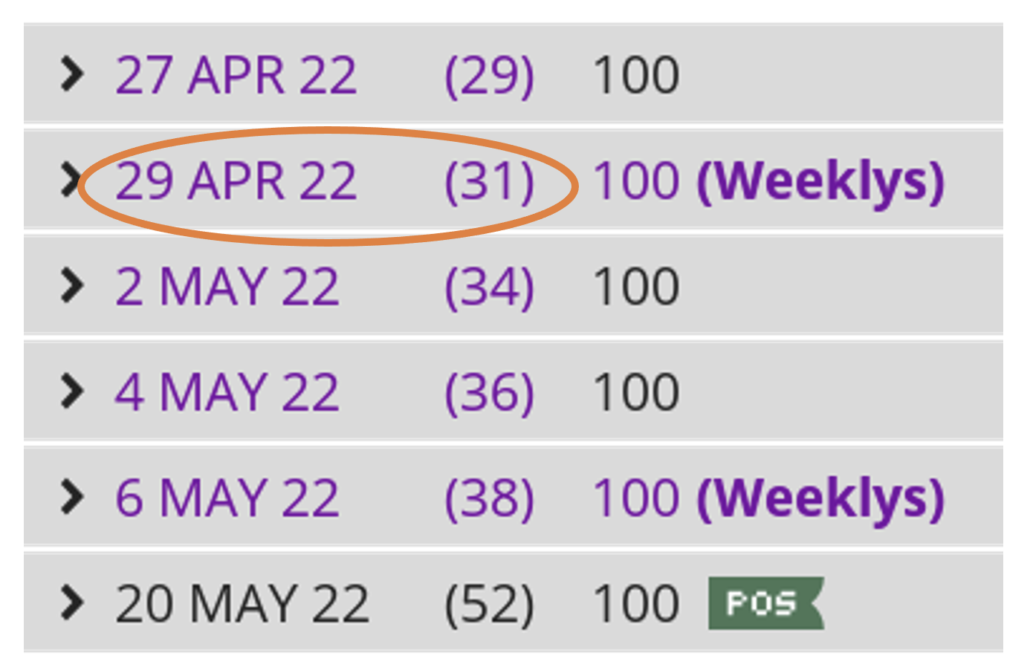

Slide 39
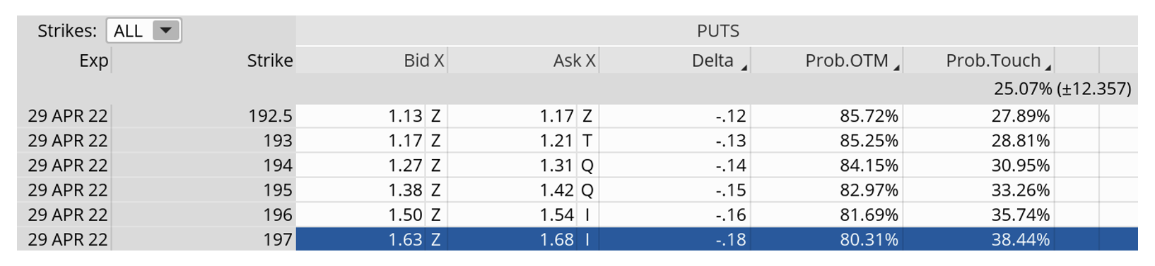

Slide 40
The Trade: IWM 197/193 Bull Put Spread
Simultaneously:
Sell to open IWM April 29, 2022, 197 strike
Buy to open IWM April 29, 2022, 193 strike for a total net credit of roughly $0.46 or $46 per bear call spread
Probability of Success: 80.31%
Total net credit: $0.46, or $46 per bull put spread
Total risk per spread: $3.54, or $354 per bull put spread
Max Potential Return: 13.0%

Slide 41
Risk Management

Slide 42
Iron Condor

Slide 43
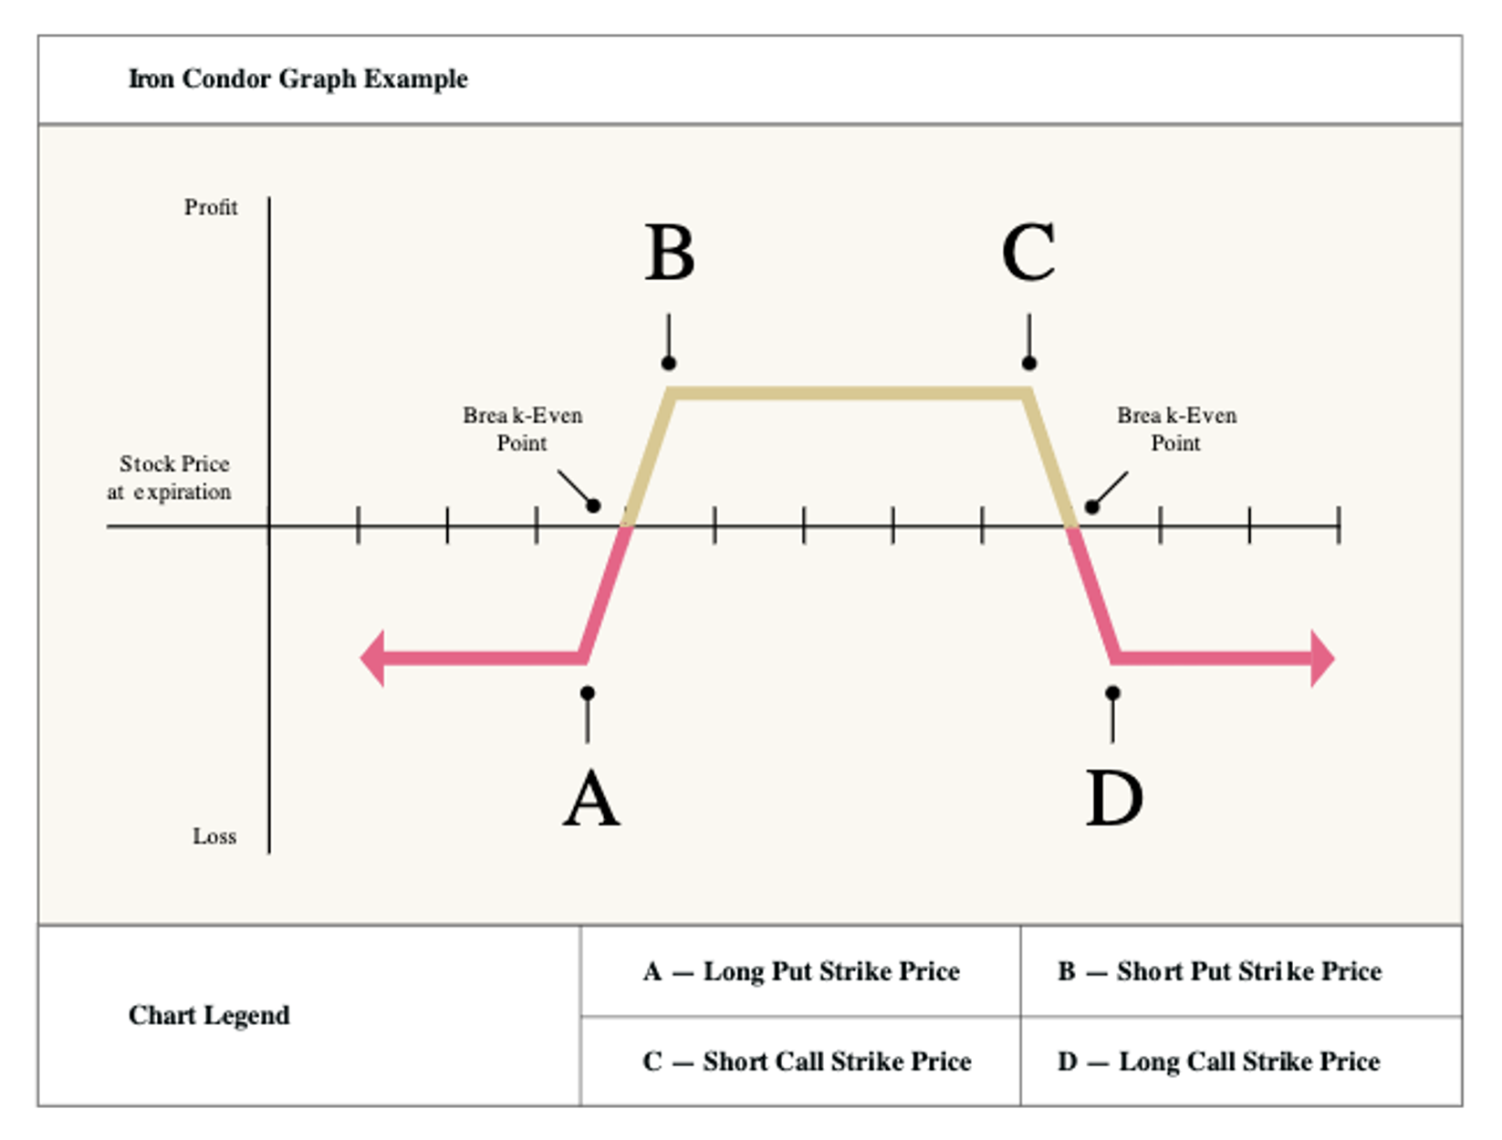

Slide 44
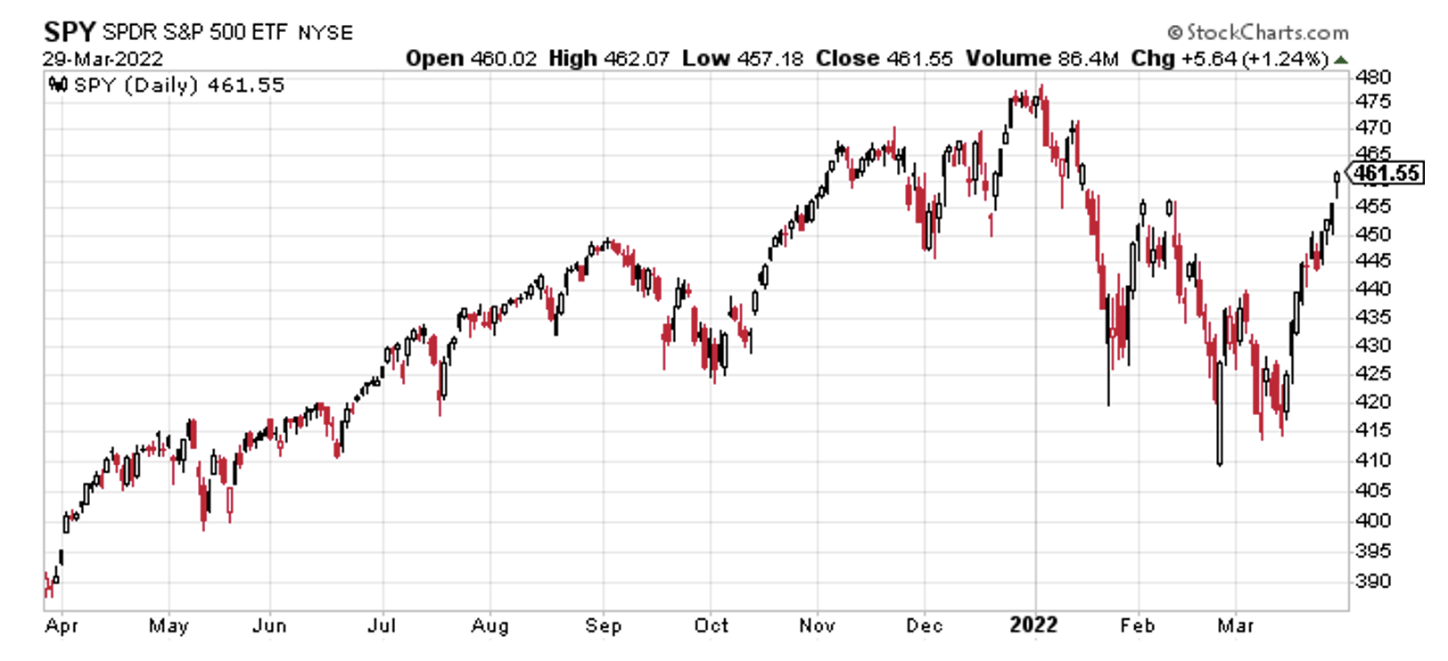

Slide 46
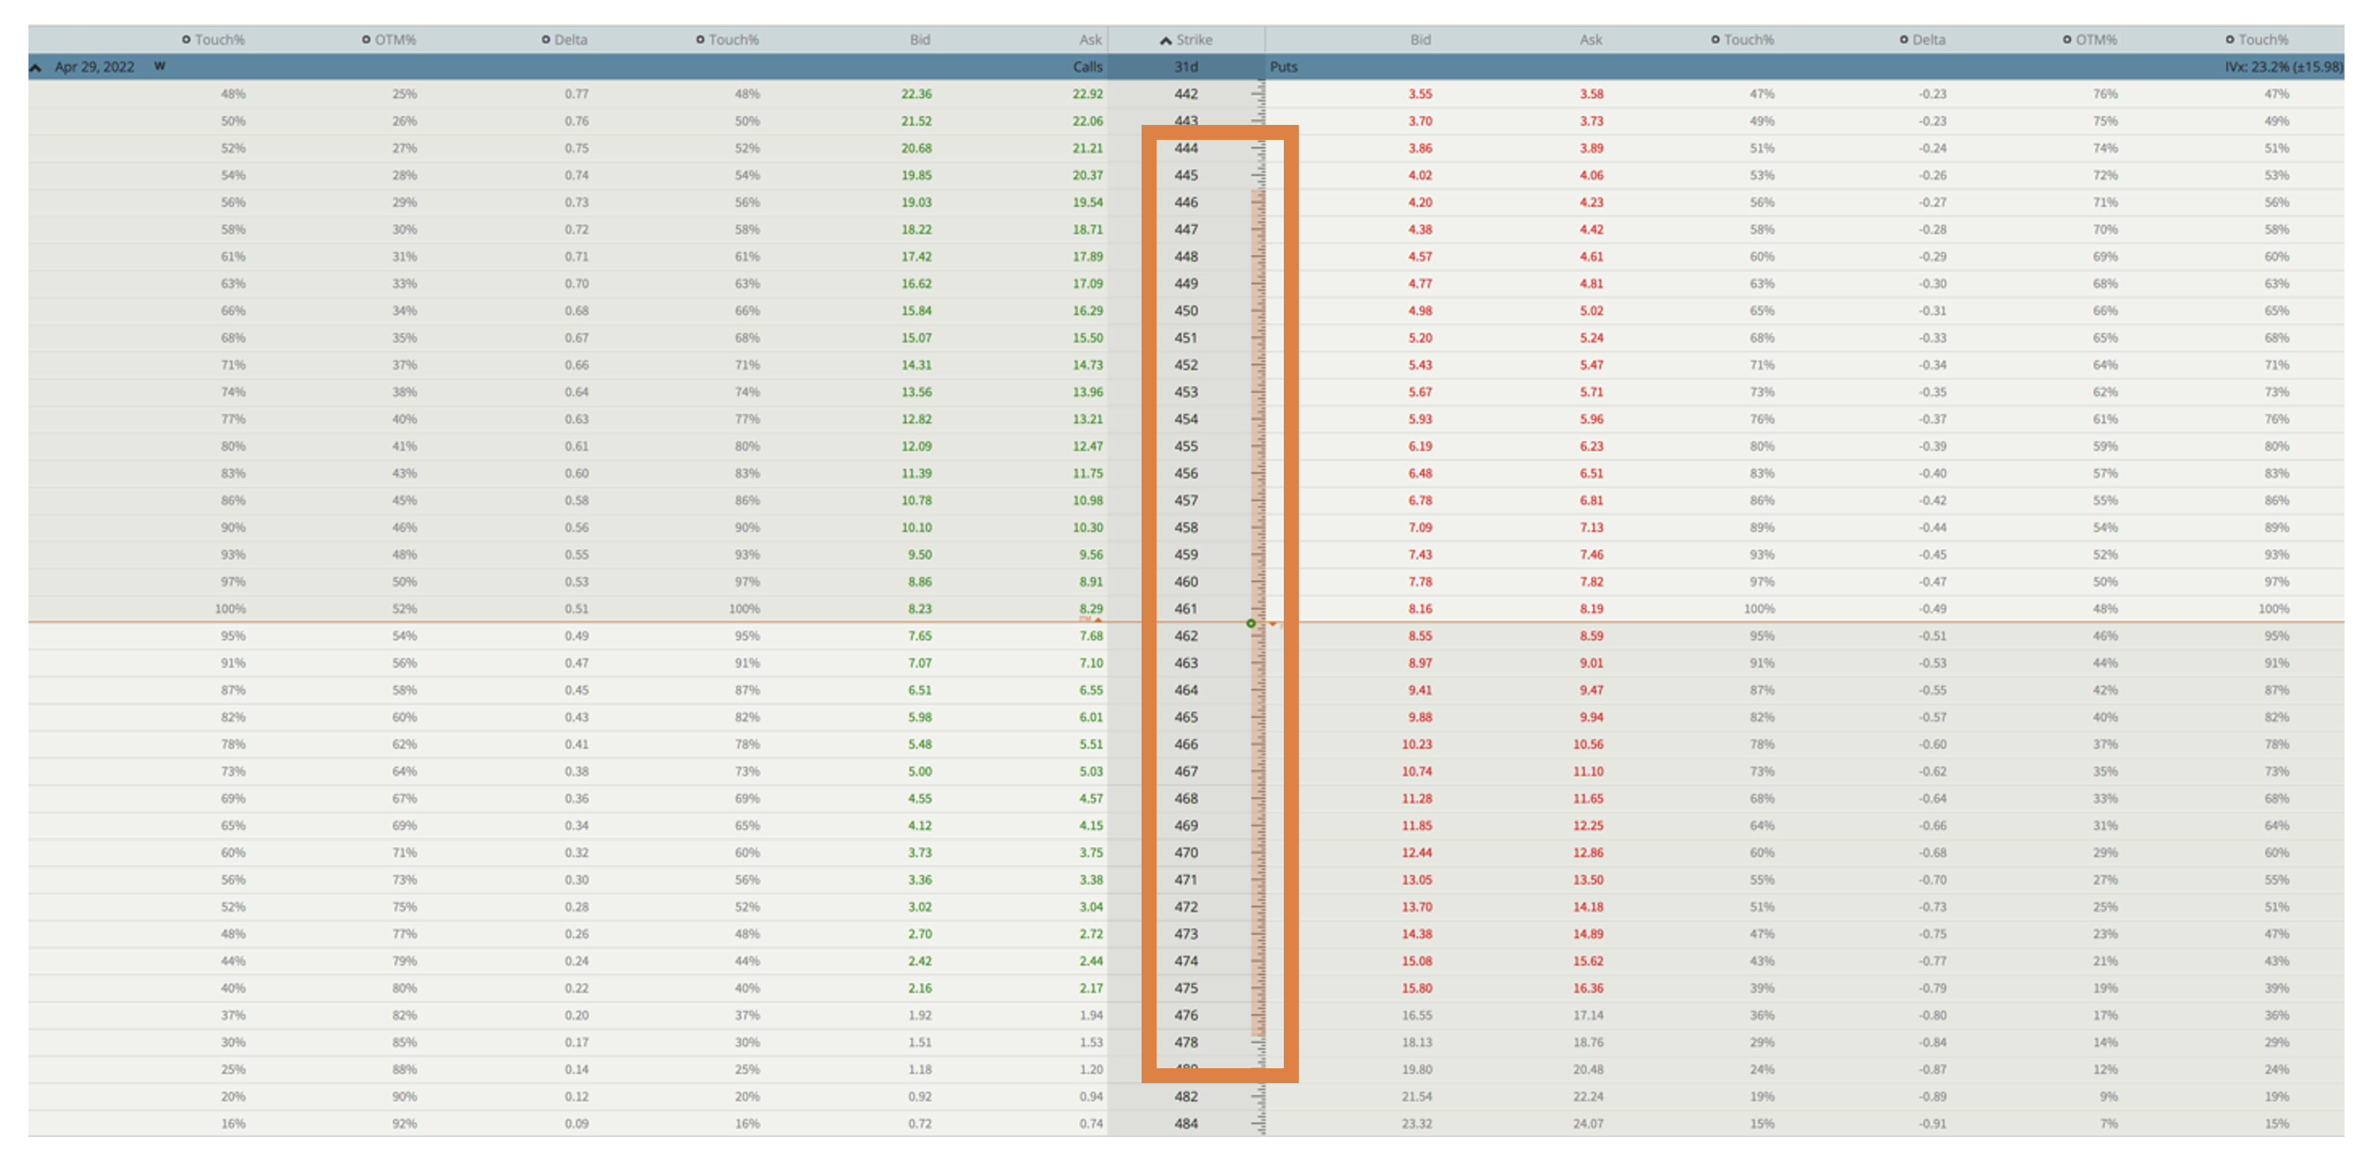

Slide 47
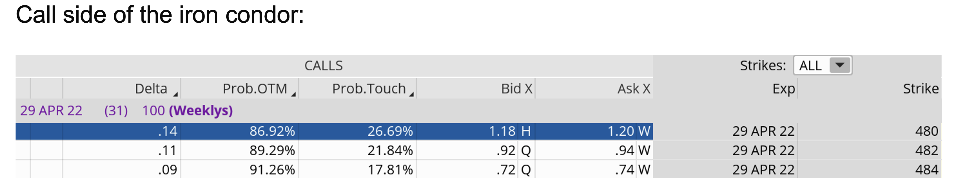

Slide 48
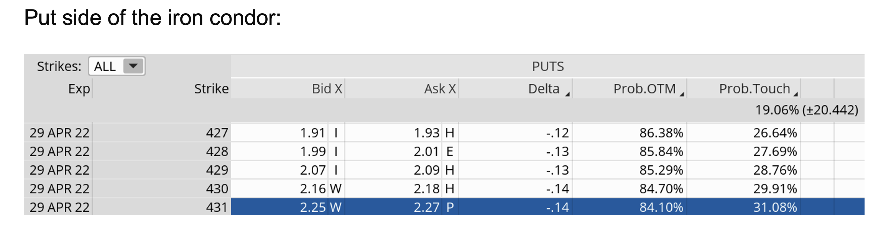

Slide 49
The Iron Condor Trade
Simultaneously…
Sell to open SPY April 29, 2022 480 calls
Buy to open SPY April 29, 2022 484 calls
Sell to open SPY April 29, 2022 431 puts
Buy to open SPY April 29, 2022 427 puts
Probability of Success: 86.92% (upside) and 84.10% (downside)
Total net credit: $0.80, or $80 per iron condor
Total risk per spread: $3.20, or $320 per iron condor
Max Potential Return: 25.0%

Slide 50
Risk Management

Slide 51
Questions?

Slide 52


Launch Special:
Get Cabot Options Institute Masters Club for Half Price
Cabotwealth.com/coi

Slide 53
Contact
Andy Crowder, Chief Analyst
Cabot Options Institute Masters Club
Cabot Options Institute Quant Trader
Cabot Options Institute Income Trader
Cabot Options Institute Fundamentals
Cabot Options Institute Earnings Trader
Support@CabotWealth.com

