Slide 1
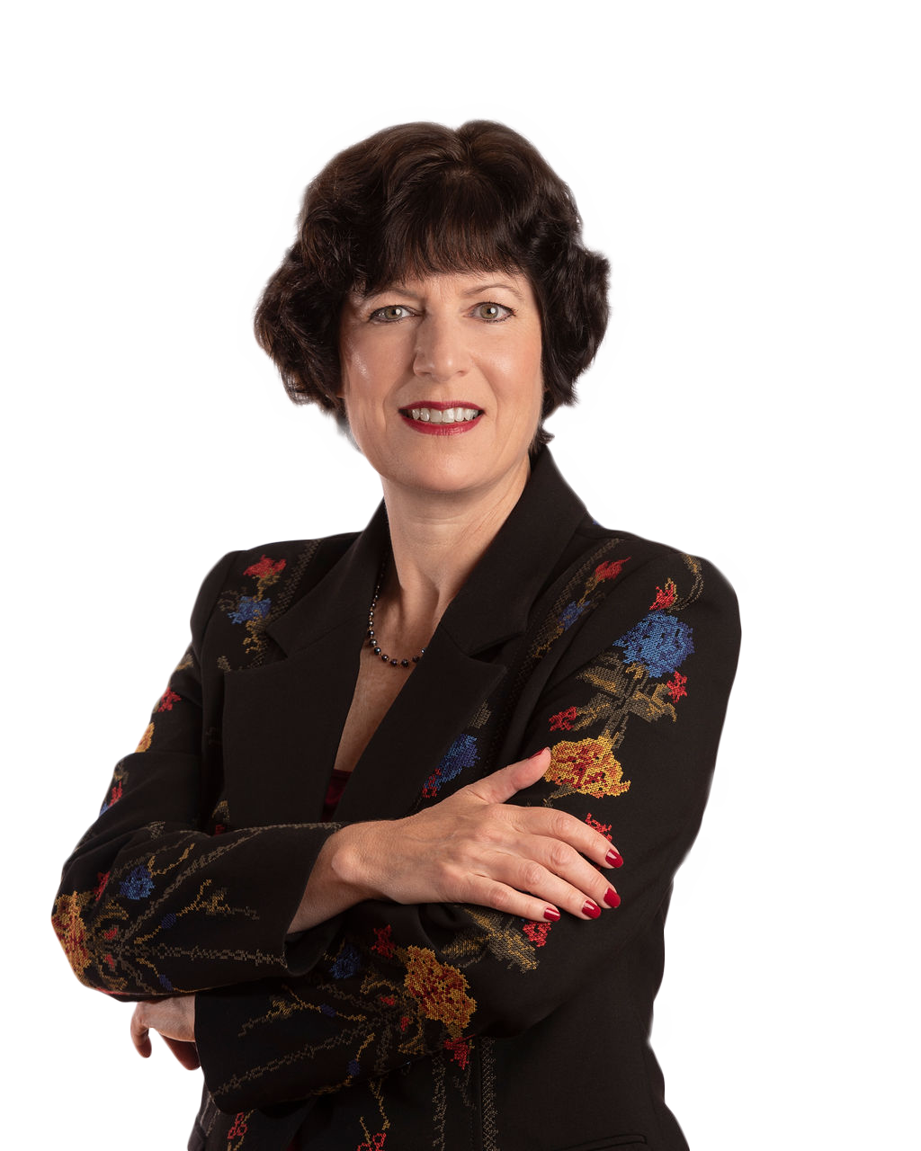
7 Undervalued Growth Stocks with Rising Dividends for This Market
Crista Huff, Chief Analyst Cabot Undervalued Stocks Advisor

Slide 2
The First Quarter 2018 Stock Market Drop
On January 25, 2018, MarketWatch called me for some color on the market, and here’s what they published:
“Crista Huff, chief analyst at Cabot Undervalued Stocks Advisor, said that she is advising her clients to be prepared for a correction, defined as a drop of at least 10% from a recent peak…”
The S&P 500 index peaked the next day, then fell 10.2% until it bottomed on February 8, 2018. Seven months later, the market began reaching new highs again.

Slide 3
The Fourth Quarter 2019 Stock Market Run-Up
On October 21, 2019, in an article titled "It's Time For Another Stock Market Run-Up,” I wrote:
“I’m not going too far out on a limb in saying that the stock market could begin a new run-up into all-time high territory this month.”
The S&P 500 index began reaching new all-time highs within a week, proceeding to rise 12% to its subsequent peak in February.

Slide 4
The Global Reach of the Chinese Coronavirus
The title of my January 22, 2020 weekly update was, “We’re Due for a Stock Market Correction.”
Citing the 2020 commerce disruption emanating from the outbreak of the coronavirus in China, I stressed that this situation would harm first-quarter revenue and profits at most American companies, and consequently affect their share prices. I spent several weeks giving investors specific ideas on how to protect and prune their portfolios in order to raise cash so that they could buy low after the coming market correction.

Slide 5
Using Stop-Loss Orders After Big Run-Ups
On January 17, 2020, in an article titled, "Make More Money With Apple Stock During the Next Market Correction,” I talked about using stop-loss orders on Apple Inc. (AAPL), with the intention of buying the shares back low during the next market correction. I employed this strategy repeatedly in recent years, and later repurchased AAPL shares in 2019 on January 28 at 156.09, May 13 at 187.49 and August 6 at 197.71 during market pullbacks.

Slide 6
Apple Inc. (AAPL)
On March 9, I added Apple (AAPL) to my Cabot Undervalued Stocks Advisor portfolios with a Strong Buy recommendation, since the price was on sale again.
I know from repeated experience that the stock will go on to recover from the downturn, and will later reach new all-time highs again.

Slide 7
Profiting with Bearish ETFs
On February 24, I added SPXS and SOXS to my stock letter. These are two exchange-traded funds that rise in value as the S&P 500 index and the technology sector fall, respectively. I consider these investments appropriate for traders and very experienced investors.

Slide 8
Features of Today’s Portfolio Stocks
Annually rising dividend payouts
Annually rising profits
Decent one-year price charts

Slide 9
Sector Diversification
Basic Materials – lumber & wood production
Financial – alternative asset manager
Financial – risk management insurance
Healthcare – drug manufacturer
Healthcare – healthcare plans
Industrials – railroads
Industrials – aerospace & defense
Technology – semiconductor equipment & materials

Slide 10
Portfolio Stocks
Anthem (ANTM)
Applied Materials (AMAT)
Assurant (AIZ)
Blackstone Group (BX)
Boise Cascade (BCC)
Bristol-Myers Squibb (BMY)
Kansas City Southern (KSU)
L3Harris Technologies (LHX)

Slide 11
Anthem (ANTM)
Healthcare – healthcare plans
Operates Blue Cross and Blue Shield plans in 14 states with an average 35% membership per states
Management’s goal: double-digit revenue and earnings growth
ANTM was included in a list of 12 large companies identified as potential Buffett takeovers by Credit Suisse.

Slide 12
Anthem (ANTM)
Share Price $238.32
Dividend Payout $3.80
Dividend Yield 1.59%
Annual dividend increase announced late January
Reiterated $22.30 ’20 EPS guidance last week
Very good 2020 and 2021 earnings growth projections
Repurchased $1.7 billion of stock in 2019, with $3.8 billion remaining in the repurchase authorization

Slide 13
Applied Materials (AMAT)
Technology – semiconductor equipment & materials
A worldwide leader, actively growing market share in semiconductor capital equipment

Slide 14
Applied Material (AMAT)
Share Price $44.86
Dividend Payout $0.88
Dividend Yield 1.96%
Annual dividend increase was announced last week
Great 2020 and good 2021 earnings growth projections
Repurchased $200 million of stock during the quarter ended January 31

Slide 15
Assurant (AIZ)
Financial – risk management insurance
Areas of coverage include mobile device protection, homeowners’ insurance, annuities and funeral insurance.
Assurant’s 2018 acquisition of The Warranty Group expanded the company’s global presence and distribution partners. The transaction was immediately profitable, cost synergy goals have been met, and continued multi-year revenue and profit growth is expected.

Slide 16
Assurant (AIZ)
Share Price $92.50
Dividend Payout $2.52
Dividend Yield 2.72%
Annual dividend increase in November
Good 2020 and 2021 earnings growth projections
Repurchased $275 million of stock in 2019 with $466 million remaining in the repurchase authorization as of February 7

Slide 17
Blackstone Group (BX)
Financial – alternative asset management
CEO Stephen Schwarzman
Best in Class among alternative asset managers
AUM $571 Billion
July 2019 converted from an LP to a C-corp

Slide 18
Blackstone Group (BX)
Share Price $41.44
Dividend Payout $1.95 TTM
Dividend Yield 4.71%
Dividend varies each quarter
Great 2020 and 2021 earnings growth projections
Repurchased $3.0 billion of stock in 2019 with $781 million remaining in the repurchase authorization as of December 31

Slide 19
Boise Cascade (BCC)
Basic materials – lumber & wood production
Products include veneer lumber, laminated beams, I-joists and industrial plywood panels.
The company sells products in the U.S. and Canada.

Slide 20
Boise Cascade (BCC)
Share Price $25.84
Dividend Payout $0.40
Dividend Yield 1.55%
Annual dividend increase announced in November
Great 2020 and good 2021 earnings growth projections
The company typically pays an annual special dividend, in addition to the quarterly dividends. The 2019 special dividend totaled $1.00 per share.

Slide 21
Bristol-Myers Squibb (BMY)
Healthcare – drug manufacturer
BMY purchased Celgene for $74 billion in November 2019.
During the transaction, Celgene sold OTEZLA psoriasis treatment to Amgen (AMGN) for $13.4 billion.
The company sells drugs that treat cardiovascular, oncology and immune disorders, including Coumadin, Eliquis and Revlimid.
BMY’s financial priorities include share repurchases, debt repayment and annual dividend increases.

Slide 22
Bristol-Myers Squibb (BMY)
Share Price $54.09
Dividend Payout $1.80
Dividend Yield 3.33%
Annual dividend increase announced in December
Great 2020 and 2021 earnings growth projections
Fall 2019 – Bristol-Myers raised their accelerated share repurchase authorization from $5 billion to $7 billion

Slide 23
Kansas City Southern (KSU)
Industrials – railroads
Operates a north-south central U.S. railroad franchise, with 50% of operations in coast-to-coast Mexico.
As of December 2019, the company intends to deploy available cash in the following ratio:
40-50% to capital projects and strategic investments
50-60% to share repurchases and dividends

Slide 24
Kansas City Southern (KSU)
Share Price $121.20
Dividend Payout $1.60
Dividend Yield 1.32%
Random dividend increases; last November 2019
Very good 2020 and 2021 earnings growth projections
In December 2019, the company announced a new $2 billion share repurchase authorization.

Slide 25
L3Harris Technologies (LHX)
Industrials – aerospace & defense
June 2019 merger between Harris Corp. and L3 Technologies
The company is reshaping their business portfolio toward “high-margin, high-growth, technology-differentiated businesses where we can win and generate attractive returns.”
Selling their airport securities business for $1 billion. Some of the cash will be used to repurchase shares.
The company is considering the sale of another approximate $800 million of businesses, with a goal of divesting 8-10% of their businesses.

Slide 26
L3Harris Technologies (LHX)
Share Price $168.95
Dividend Payout $3.40
Dividend Yield 2.01%
Dividends are recent, with frequent increases
Good 2020 and 2021 earnings growth projections

Slide 27
Market Capitalization
Large-cap: Anthem (ANTM) Applied Materials (AMAT) Bristol-Myers Squibb (BMY) Blackstone Group (BX) L3Harris Technologies (LHX)
Mid-cap: Assurant (AIZ) Kansas City Southern (KSU)
Small-cap: Boise Cascade (BCC)

Slide 28
Best Choices
Best dividend yields and best earnings growth:
Bristol-Myers Squibb (BMY)
Blackstone Group (BX)
Best price chart: Anthem (ANTM)

Slide 29
Reference Materials
“Getting Started with a $10,000 Stock Portfolio”
You can locate this article by using the SEARCH feature at www.CabotWealth.com.
How to Find Dividend History
Visit old.nasdaq.com
Type in stock symbol (top center)
Click on Dividend History (blue tool bar on left side of page)

Slide 30
Special Webinar $1 Introductory Deal
Right now there are great undervalued investment opportunities now for those who in the know. Let value investing expert Crista Huff show you how. Don’t miss out. Subscribe today.
Monthly issues with our latest recommendations and updates on all the stocks our 3 portfolios
Updates and trading alerts between issues
24/7 online access to exclusive subscriber website
Direct access to Chief Analyst Crista Huff for answers to your questions.
Limited to the first 250 so please act now. CabotWealth.com/webinarspecial

Slide 31
Questions
You may submit questions using the chat box.
Upcoming Events
Cabot Wealth Summit 2020 8th annual investor conference with Cabot Wealth Network analysts Wednesday-Friday, August 19-21 | Hawthorne Hotel | Salem, Mass. More information or to register: CabotWealth.com/summit
[FREE Webinar] Growth Stocks for the Coronavirus Recovery Tim Lutts, CEO & Chief Investment Strategist, Cabot Wealth Network Wednesday, April 22 at 2PM ET. Sign up now at CabotWealth.com/webinars

Slide 32
Contact
Crista Huff, Chief Analyst
Cabot Undervalued Stocks Advisor
Support@CabotWealth.com
Special Webinar $1 Introductory Deal
Monthly issues … updates and trading alerts … 24/7 online access … access to Crista Huff Limited to first 250. Act now. CabotWealth.com/webinarspecial

