Slide 1
Cabot Options Institute Income Trader Subscriber-Exclusive Webinar
Andy Crowder, Chief Options Strategist Cabot Options Institute

Slide 2
Over the Next Hour
Expiration Cycle
Strategy Review
Closed Trades
Open Positions
Potential Trades
Questions and Answers

Slide 3
Expiration Cycle

Slide 4
Strategy Review

Slide 5
Selling Puts

Slide 6
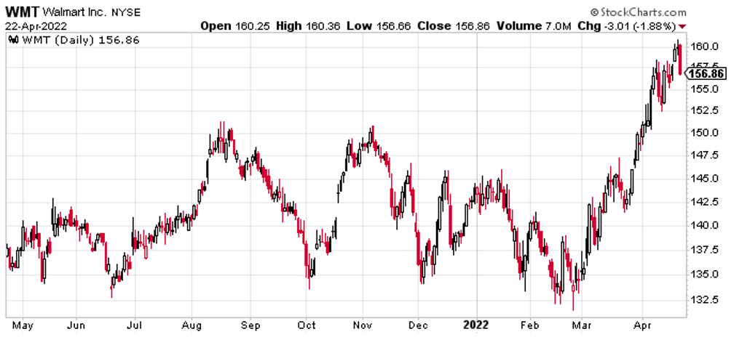

Slide 7
The Trade: Sell WMT 148 Puts for a net credit of $2.15
Probability of Success: 72.14%
Total net credit: $2.15, or $215
Max Potential Return: 1.4% cash-secured or 12.6% annually

Slide 8
Risk Management

Slide 9
Closed Positions

Slide 10
Open Positions

Slide 11
Potential Trades
Notes:
QQQ, XOP, SPY, IWM, DIA, EEM, EFA, XLF

Slide 12
Questions & Answers

Slide 13
Thank You!

