Slide 1
Welcome
The webinar will begin at 2:00 PM Eastern.
You may listen via your computer audio or dial in using your phone.
Please submit your questions via the chat feature.

Slide 2
The 5 Best Stocks to Buy in March
Mike Cintolo
Vice President of Investments and Chief Analyst
Cabot Growth Investor and Cabot Top Ten Trader

Slide 3
Current Market
Thanks to coronavirus fears, market’s intermediate-term uptrend has been cracked
Long-term bull market remains intact
Trend is Up
Many leaders down, not broken
Lots of long-term breakouts Oct/Nov
But—correction likely in force for a while
Hold some cash, be patient, buy leading names into support

Slide 4
Stock #1: Amazon.com (AMZN)
You know the story
Mega-cap stock boosted by huge launching pad on earnings
Company is finally consistently profitable: EPS +24% this year, +41% next year
Recently emerged from year-plus consolidation – typically bodes well for higher share prices in mega caps

Slide 5
Amazon.com (AMZN)

Slide 6
Stock #2: Dynatrace (DT)
New leader in application performance management.
Accelerating revenue growth, encouraging earnings and cash flow
Strong earnings breakout a few weeks ago extended uptrend; recent mini-dip = good entry point

Slide 7
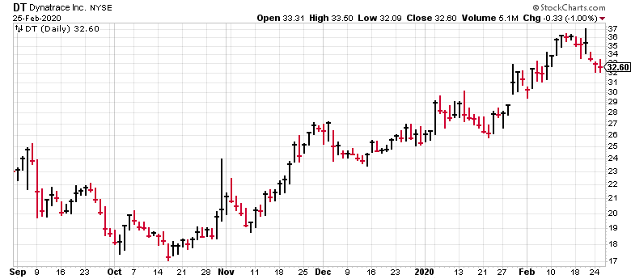
Dynatrace (DT)

Slide 8
Stock #3: HealthEquity (HQY)
America’s largest non-bank health savings trustee
Allows customers to lower monthly premiums and long-term payments via Health Savings Accounts
Expanding reach: total # HSAs for FY 2020 +34%, total accounts +180%, HSA assets +43%
Stock fell 40% in 2018, bottomed last year, now resuming long-term uptrend

Slide 9
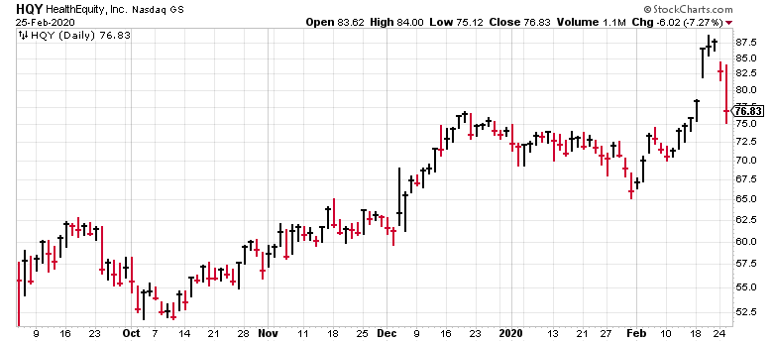
HealthEquity (HQY)

Slide 10
Stock #4: Redfin (RDFN)
Popular real estate website aiming to revolutionize brokerage industry
Own team of agents charging lower commissions than big brokerage firms
33 million monthly visitors, up 21% year over year
Uptrend in housing market = 5 straight qtrs. rev. growth
Stock emerging from giant post-IPO base

Slide 11
Redfin (RDFN)

Slide 12
Stock #5: Uber (UBER)
Household name that fell flat after overhyped IPO in 2019
Coming off first positive earnings report: revenues +39%, gross bookings +30%, on track to turn EBITDA positive this year
International platform making it preferred operating system, mode of transportation in hundreds of cities around the world
Stock has come to life since Nov. bottom; still below IPO highs

Slide 13
Uber (UBER)

Slide 14
Special Webinar Introductory Offer: Cabot Top Ten Trader for just $1
Full access, for a full 30 days, for just a buck! Limited to the first 250 respondents so please act now.
CabotWealth.com/webinarspecial
Sign Up Now
Here’s what you receive with Cabot Top Ten Trader …
10 trades each week, including a “top pick” in each issue of Cabot Top Ten Trader
Complete buy, sell and profit instructions
24/7 online access to the private Cabot Top Ten Trader website
Direct access to Chief Analyst Mike Cintolo
*Offer valid for new subscribers only.

Slide 15
Questions?
Upcoming Events 7 Undervalued Growth Stocks with Rising Dividends for this Market [FREE WEBINAR] Presented by Crista Huff, Chief Analyst, Cabot Undervalued Stocks Advisor Wednesday, March 18, 2020 at 2:00 pm ET CabotWealth.com/webinar
8th Annual Cabot Wealth Summit August 19-21, 2020 | Salem, Massachusetts CabotWealth.com/summit

Slide 16
Contact
Mike Cintolo, Chief Analyst Cabot Top Ten Trader and Cabot Growth Investor Mike@CabotWealth.com
SPECIAL WEBINAR INTRODUCTORY OFFER
Try it for $1. Full access, for a full 30 days, for just a buck! Limited to the first 250 respondents so please act now.
CabotWealth.com/webinarspecial
*Offer valid for new subscribers only.

