Slide 1
The Easiest Way to Make 10% in this Down Market
Andy Crowder, Chief Options Strategist Cabot Options Institute

Slide 2
Welcome!

Slide 3
Over the Next Hour
How We’ll Make You Money
The Five Main Strategies
Our Approach
Questions and Answers
Real-Time Trades

Slide 4
How We’ll Make You Money

Slide 5
The Five Main Strategies

Slide 6
The Five Strategies
Dalio’s All-Weather Strategy
Swensen’s Yale Endowment Portfolio
Dogs of the Dow
O’Shaughnessy’s Growth-Value Portfolio
Buffett’s Patient Investor

Slide 7
Passive Strategies
Dalio’s All-Weather Strategy
Swensen’s Yale Endowment Portfolio
Dogs of the Dow

Slide 8
Passive Strategies: All-Weather
Positions
iShares 20+ Year Treasury Bond ETF (TLT)
iShares 7-10 Year Treasury Bond ETF (IEF)
Invesco DB Commodity Index Tracking Fund (DBC)
SPDR Gold Trust (GLD)
Vanguard Total Stock Market ETF (VTI)

Slide 9
Passive Strategies: Yale Endowment
Positions
SPDR S&P 500 ETF (SPY)
iShares MSCI Emerging Market ETF (EEM)
Vanguard Real Estate (VNQ)
iShares Trust TIPS ETF (TIP)
iShares trust MSCI EAFE ETF (EFA)

Slide 10
Passive Strategies: Dogs of the Dow
Image: DogsoftheDow.com

Slide 11
Active Strategies
O’Shaughnessy’s Growth-Value Portfolio
Buffett’s Patient Investor

Slide 12
Active Strategies: O’Shaughnessy’s Growth-Value
Five to ten positions, with a monthly rebalancing
The strategy makes sense for value-oriented growth investors
Also appropriate for income-oriented investors
Example of past positions: Chevron (CVX), Exxon (XOM), Dick’s Sporting Goods (DKS), Intel (INTC)

Slide 13
Active Strategies: Buffett’s Patient Investor
Five to ten positions, with a monthly rebalancing
Focus on companies with strong businesses and good long-term prospects
Only stocks with a long-term track record are included
Example of past positions: Apple (AAPL), Tractor Supply (TSCO), Mastercard (MA)

Slide 14
Our Approach

Slide 15
Poor Man’s Covered Calls

Slide 16
Invesco DB Commodity Index Tracking Fund (DBC)

Slide 17
DBC LEAPS
June 8, 2022
The DBC January 19, 2024 call options with 590 days left until expiration and a delta of 0.79, was trading for roughly $10.50.

Slide 18
Selling Near-Term Calls in DBC
June 8, 2022
The July 15, 2022 call with 37 days left until expiration and a delta of 0.32 is trading for $0.55.

Slide 19
Premium in a High Volatility Environment
My total outlay for the entire position now stands at $9.95, or $995 ($10.50 – $0.55).
The premium collected is 5.2% over 37 days. Not a ton of premium, but remember, we are going out roughly 30 days and using an ETF that has, by most comparisons, a modest level of implied volatility (IV).

Slide 20
LEAPS: January 19, 2024 22 calls (590 dte)
Short Calls: July 15, 2022 32 calls (37 dte)
Notes:
.

Slide 21
The Trade
Buy to open January 19, 2024, DBC 22 calls for $10.50 (prices may vary, adjust accordingly)
Once that occurs:
Sell to open July 15, 2022, DBC 32 calls for $0.55 (prices may vary, adjust accordingly)

Slide 22
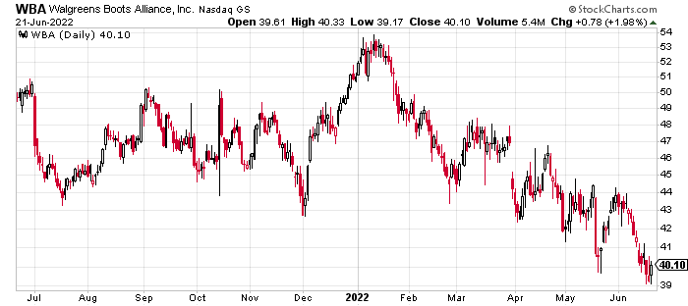
Walgreens Boots Alliance (WBA)

Slide 23
WBA LEAPS
June 21, 2022
The WBA January 19, 2024 call options with 577 days left until expiration and a delta of 0.78, was trading for roughly $11.60.

Slide 24
Selling Near-Term Calls in WBA
June 21, 2022
The July 29, 2022 call with 38 days left until expiration and a delta of 0.35 is trading for roughly $1.00.

Slide 25
Premium in a High Volatility Environment
My total outlay for the entire position now stands at $10.60, or $1,060 ($11.60 – $1.00).
The premium collected is 8.6% over 38 days.

Slide 26
LEAPS: January 19, 2024 30 calls (577 dte)
Short Calls: July 29, 2022 42 calls (38 dte)

Slide 27
The Trade
Buy to open January 19, 2024, WBA 30 calls for $11.60 (prices may vary, adjust accordingly)
Once that occurs:
Sell to open July 29, 2022, WBA 42 calls for $1.00 (prices may vary, adjust accordingly)

Slide 28
Risk Management

Slide 29
Trading Platform

Slide 30
Claim your Charter Subscription to Cabot Options Institute Fundamentals right now and get all the basics you need to know about trading options. Your subscription includes:
Monthly Issues: You get all the fundamentals about options-trading strategies and tactics and the latest recommended trades.
Updates & Alerts: Featuring the most recent news on our advice and current market conditions.
Member Calls: You get free registration to monthly options-trading Member Calls, hosted by Chief Analyst Andy Crowder.
FREE Special Report: Instant access to The #1 Fundamentals Trade You Should Make Today.
Access to Chief Analyst: You get Chief Analyst Andy Crowder’s personal email address for asking your own questions about options trading.
Cabotwealth.com/coi

Slide 31
Questions?

Slide 32
Contact
Andy Crowder, Chief Analyst Cabot Options Institute Masters Club Cabot Options Institute Quant Trader Cabot Options Institute Income Trader Cabot Options Institute Fundamentals Cabot Options Institute Earnings Trader Support@CabotWealth.com

