Slide 1
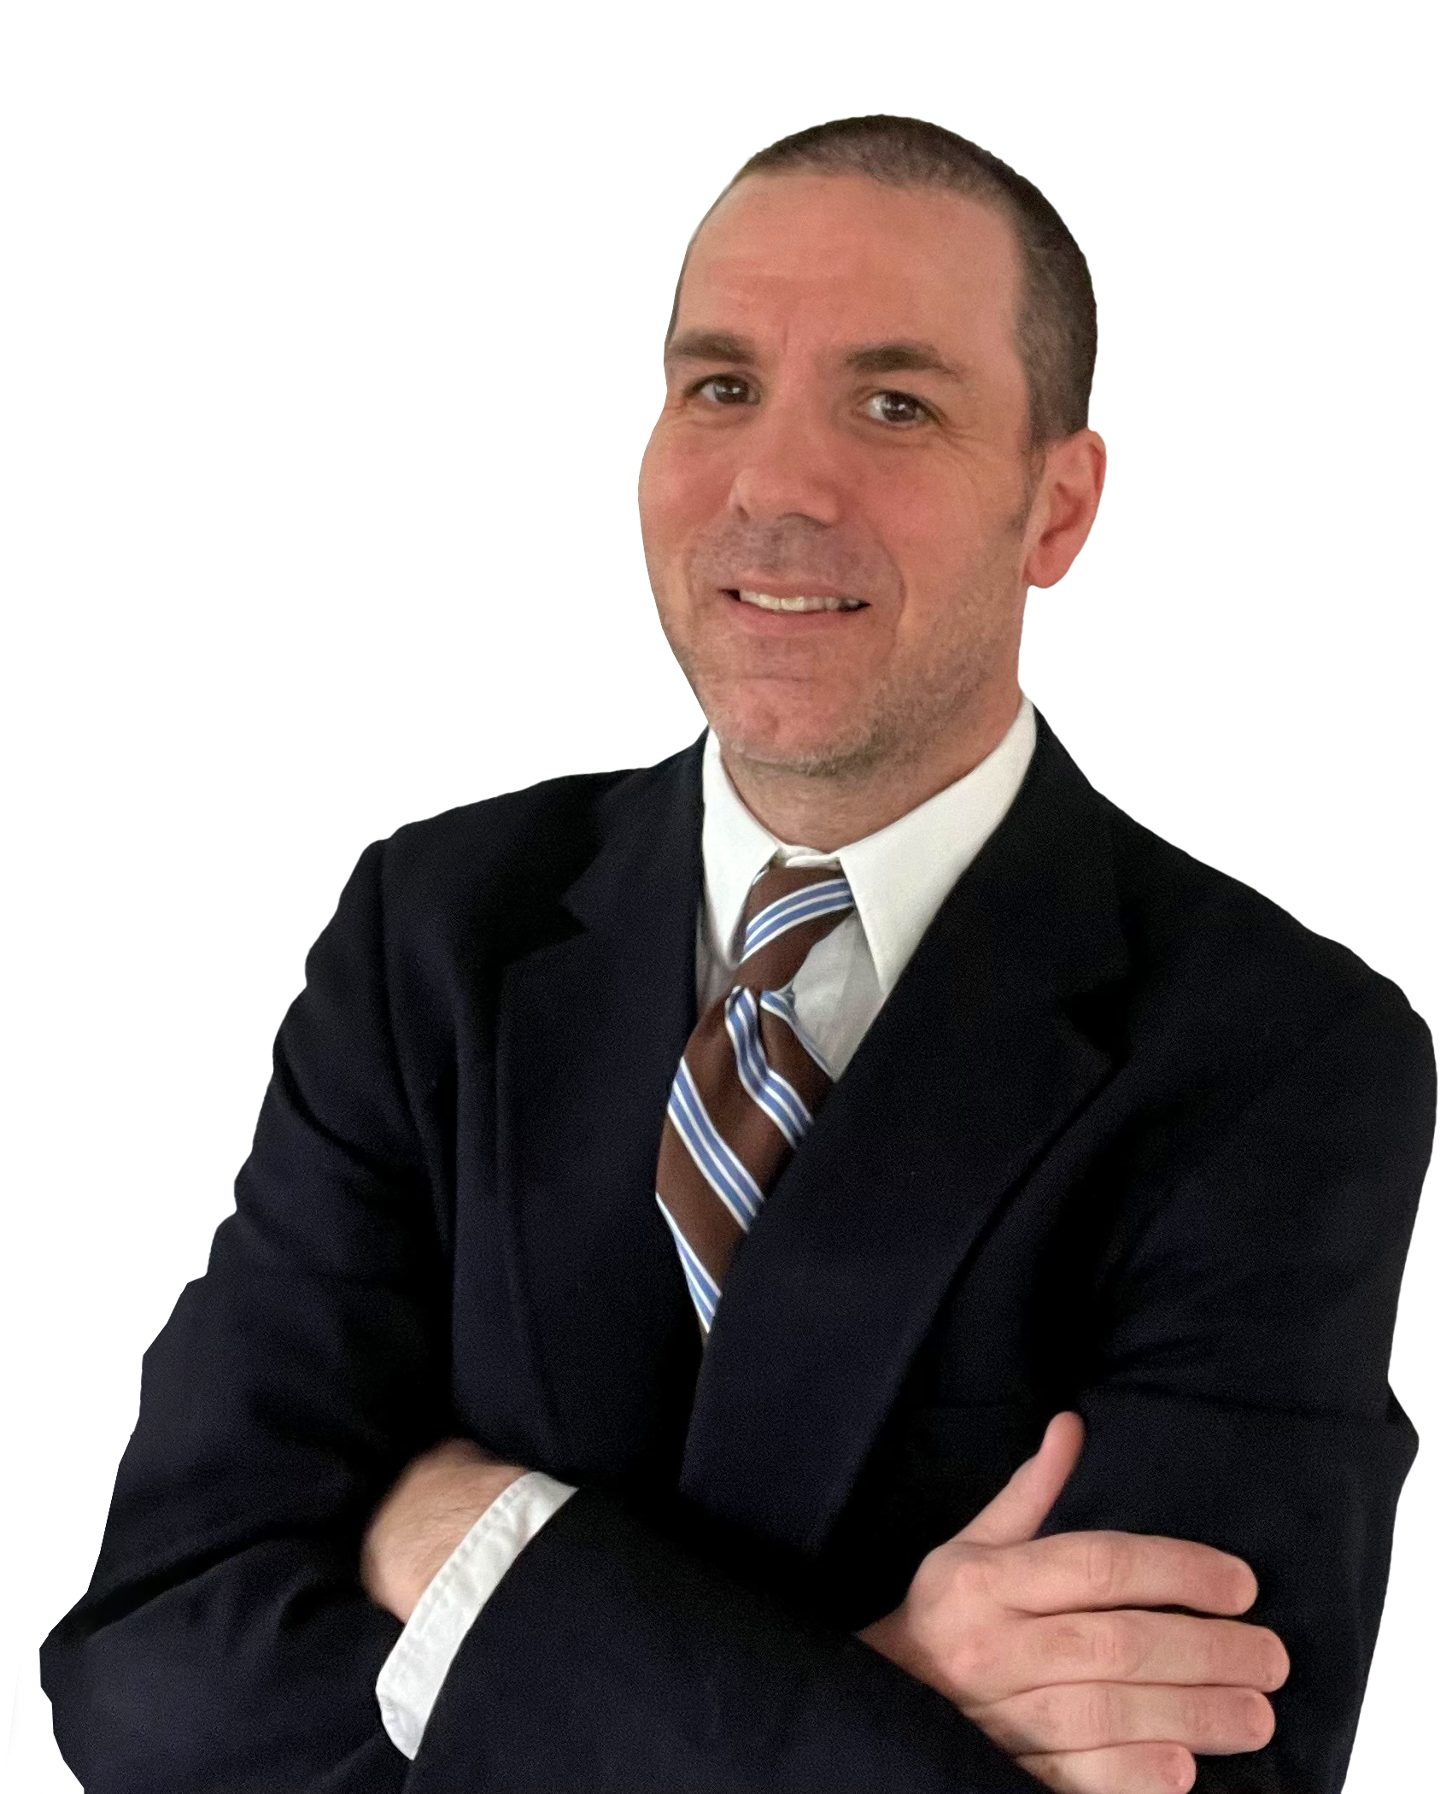
Cabot Options Institute Quant Trader Subscriber-Exclusive Webinar
Andy Crowder, Chief Options Strategist Cabot Options Institute

Slide 2
Over the Next Hour
Expiration Cycle
Strategy Review
Closed Trades
Open Positions
Potential Trades
Questions and Answers

Slide 3
Expiration Cycle

Slide 4
Strategy Review

Slide 5
Closed Positions

Slide 6
Open Positions

Slide 7
Potential Trades

Slide 8
Questions & Answers

Slide 9
Thank You!

