Slide 1
Cabot Options Institute Fundamentals Subscriber-Exclusive Webinar
Andy Crowder, Chief Options Strategist Cabot Options Institute

Slide 2
Over the Next Hour
How We’ll Make You Money
The Five Main Strategies
Our Approach
Questions and Answers
Real-Time Trades

Slide 3
The Five Main Strategies

Slide 4
The Five Strategies
Dalio’s All-Weather Strategy
Swensen’s Yale Endowment Portfolio
Dogs of the Dow
O’Shaughnessy’s Growth-Value Portfolio
Buffett’s Patient Investor

Slide 5
Passive Strategies
Dalio’s All-Weather Strategy
Swensen’s Yale Endowment Portfolio
Dogs of the Dow

Slide 6
Passive Strategies: All-Weather
Positions
iShares 20+ Year Treasury Bond ETF (TLT)
iShares 7-10 Year Treasury Bond ETF (IEF)
Invesco DB Commodity Index Tracking Fund (DBC)
SPDR Gold Trust (GLD)
Vanguard Total Stock Market ETF (VTI)

Slide 7
Passive Strategies: Yale Endowment
Positions
SPDR S&P 500 ETF (SPY)
iShares MSCI Emerging Market ETF (EEM)
Vanguard Real Estate (VNQ)
iShares Trust TIPS ETF (TIP)
iShares trust MSCI EAFE ETF (EFA)

Slide 8
Active Strategies
O’Shaughnessy’s Growth-Value Portfolio
Buffett’s Patient Investor

Slide 9
Active Strategies: O’Shaughnessy’s Growth-Value
Five to ten positions, with a monthly rebalancing
The strategy makes sense for value-oriented growth investors
Also appropriate for income-oriented investors
Example of past positions: Chevron (CVX), Exxon (XOM), Dick’s Sporting Goods (DKS), Intel (INTC)

Slide 10
Active Strategies: Buffett’s Patient Investor
Five to ten positions, with a monthly rebalancing
Focus on companies with strong businesses and good long-term prospects
Only stocks with a long-term track record are included
Example of past positions: Apple (AAPL), Tractor Supply (TSCO), Mastercard (MA)

Slide 11
Our Approach

Slide 12
Poor Man’s Covered Calls

Slide 13
Invesco DB Commodity Index Tracking Fund (DBC)

Slide 14
DBC LEAPS
June 8, 2022
The DBC January 19, 2024 call options with 590 days left until expiration and a delta of 0.79, was trading for roughly $10.50.

Slide 15
Selling Near-Term Calls in DBC
June 8, 2022
The July 15, 2022 call with 37 days left until expiration and a delta of 0.32 is trading for $0.55.

Slide 16
Premium in a High Volatility Environment
My total outlay for the entire position now stands at $9.95, or $995 ($10.50 – $0.55).
The premium collected is 5.2% over 37 days, or 46.8% annually in premium sold.
Not a ton of premium on a monthly basis, but remember, we are going out roughly 30 days and using an ETF that has, by most comparisons, a modest level of implied volatility (IV).

Slide 17
LEAPS: January 19, 2024 22 calls (590 dte)
Short Calls: July 15, 2022 32 calls (37 dte)

Slide 18
The Trade
Buy to open January 19, 2024, DBC 22 calls for $10.50 (prices may vary, adjust accordingly)
Once that occurs:
Sell to open July 15, 2022, DBC 32 calls for $0.55 (prices may vary, adjust accordingly)

Slide 19
Risk Management

Slide 20
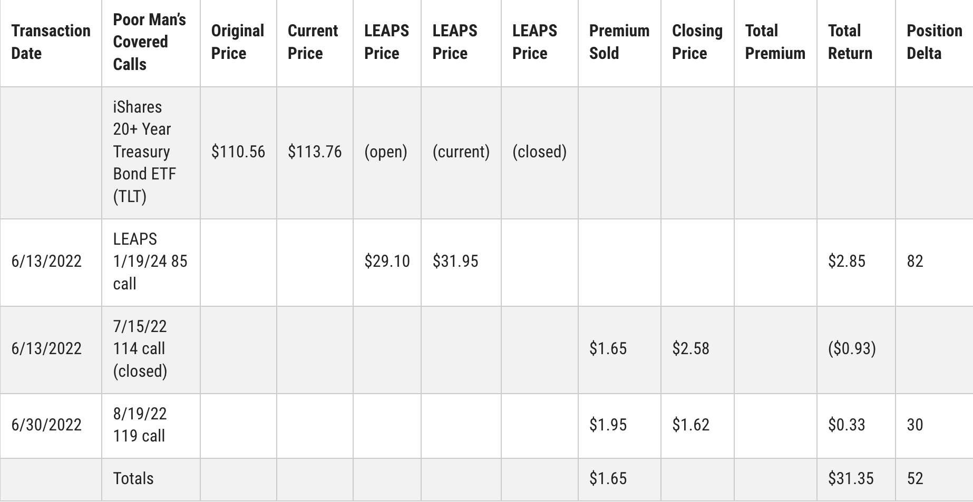

Slide 21
Managing Delta

Slide 22
Current Positions/Portfolios

Slide 23
Questions?

