Slide 1
My Favorite Growth Stocks for the Coming Coronavirus Recovery
Tim Lutts, Chief Analyst
Cabot Marijuana Investor &
Cabot Stock of the Week

Slide 3
Growth Sectors
Small Tech Growth
Medical Growth
Blue Chip Growth
Revolutionary Growth

Slide 4
Small Tech Growth Zoom Video Communications (ZM)
Cloud-based videoconferencing
Triple-digit earnings growth
Came public one year ago—so still young
Estimates 23% EPS Growth in 2021 and 37% in 2022

Slide 5
Small Tech Growth Zoom Video Communications (ZM)

Slide 6
Small Tech Growth Ring Central (RNG)
Cloud-based Unified Communications Services for Business
Phone, text, email, fax and video
91% of Revenue is Recurring

Slide 7
Small Tech Growth Ring Central (RNG)

Slide 8
Small Tech Growth Zscaler (ZS)
Cloud-based Internet Security
EPS Growth 53% next year
Profit Margins 11.8% and Growing

Slide 9
Small Tech Growth Zscaler (ZS)

Slide 10
Medical Growth Moderna (MRNA)
RNA-based Vaccine for Coronavirus
NIH Trial in Seattle
2019 Revenues $60 Million
Market Capitalization $12.5 Billion
Continuing Losses

Slide 11
Medical Growth Moderna (MRNA)

Slide 12
Medical Growth Quidel (QDEL)
Leader in rapid point-of-care tests
SARS-CoV-2 Assay Approved
Profitable for Over a Decade
$535 Million Revenue in 2019
Market Capitalization $4.2 Billion

Slide 13
Medical Growth Quidel (QDEL)

Slide 14
Medical Growth Vertex Pharmaceutical (VRTX)
Market leader in Cystic Fibrosis (CF) Tests
New triple-combo treatment Trifafta approved in U.S. and Europe
Estimates 45% EPS Growth in 2020 and 32% in 2021

Slide 15
Medical Growth Vertex Pharmaceutical (VRTX)

Slide 16
Medical Growth Gilead Sciences (GILD)
Leading provider of antiviral drugs
Remdesivir may be effective against coronavirus
Margins very high (28%) but no growth
Dividend of 3.6%
2019 Revenues $23 Billion
Market Capitalization $96 Billion

Slide 17
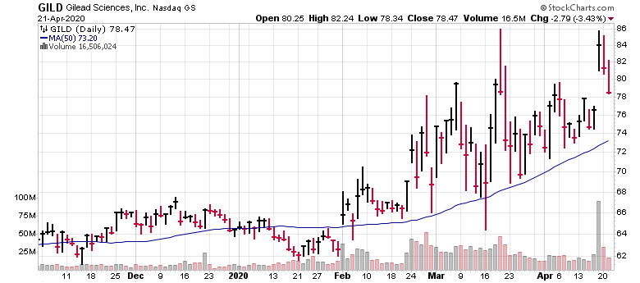
Medical Growth Gilead Sciences (GILD)

Slide 18
Blue Chip Growth Nvidia (NVDA)
World Leader in Graphics Processing Chips
Video Games, Movies, Machine Vision, Artificial Intelligence
Profit Margin 38%
Estimates 30% EPS Growth in 2021 and 20% in 2022
Small Dividend 0.2%

Slide 19
Blue Chip Growth Nvidia (NVDA)

Slide 20
Blue Chip Growth Netflix (NFLX)
Global Leader in Streaming Video
Great Recurring Income
Estimates 44% EPS Growth in 2020 and 41% in 2021
DVDs now 1% of business

Slide 21
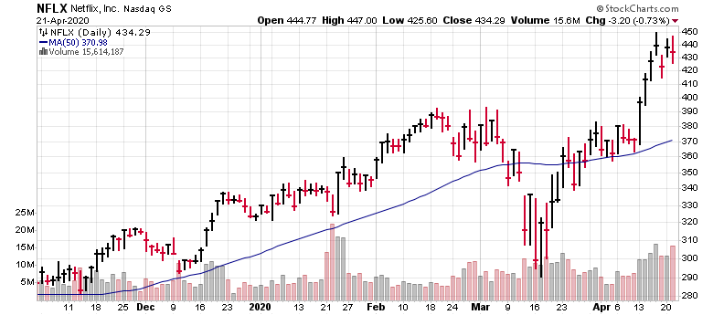
Blue Chip Growth Netflix (NFLX)

Slide 22
Blue Chip Growth Apple (AAPL)
Estimates 6% EPS Growth in 2020 and 19% in 2021
Dividend 1.1%
Computing Leadership Baton
IBM-Mainframe
Microsoft-Desktop
Apple-Phone
No successor in sight

Slide 23
Blue Chip Growth Apple (AAPL)

Slide 24
Revolutionary Growth Sector
“That won’t work!”

Slide 25
Revolutionary Growth Sector
“That won’t work!”
Netflix, mailing DVDs.
“Blockbuster will kill them!”

Slide 26
Revolutionary Growth Sector
“That won’t work!”
Netflix, mailing DVDs.
“Blockbuster will kill them!”
Amazon, started selling books online
“Barnes & Noble and Borders will kill them!”

Slide 27
Revolutionary Growth Sector
“That won’t work!”
Netflix, mailing DVDs.
“Blockbuster will kill them!”
Amazon, started selling books online
“Barnes & Noble and Borders will kill them!”
“Amazon started out selling books? Nobody buys books!”

Slide 28
Revolutionary Growth Tesla (TSLA)
Mission: Accelerate the world’s transition to sustainable energy.
Automobiles
Solar Power
Energy Storage
Great Synergies!
Profitable, and Ramping Up, while Legacy Manufacturers Struggle
Estimates $4.22 EPS in 2020 and $13.29 in 2021

Slide 29
Revolutionary Growth Tesla (TSLA)

Slide 30
Revolutionary Growth Virgin Galactic (SPCE)
Space tourism
Transporting passengers to orbiting destinations
Providing world-shrinking transcontinental flights
No earnings in sight
Competitors Jeff Bezos (Blue Origin) and Elon Musk (SpaceX)

Slide 31
Revolutionary Growth Virgin Galactic (SPCE)

Slide 32
Winning Investments, Made Easy
Cabot Stock of the Week Chief Analyst Tim Lutts selects the best of the best investment recommendations each week from the entire Cabot Wealth Network investment analyst team to create and track a high-profit portfolio. Subscribers receive immediate access to:
Weekly #1 stock picks with an informative and engaging weekly briefing and an update on all of the other stocks in the portfolio
Special bulletins with market update, news, and trade alerts
24/7 online access for your most recent issue, the complete library of back issues, special reports, annual forecasts, and more
Direct private access to Chief Analyst Tim Lutts for answers to your investing questions
Find out more at CabotWealth.com/CSOW

Slide 33
Questions
Please submit questions using the chat feature.
Upcoming Events
Cabot Wealth Summit 2020 8th annual investor conference with Cabot Wealth Network analysts Wednesday-Friday, August 19-21 | Hawthorne Hotel | Salem, Mass. More information or to register: CabotWealth.com/summit
[FREE Webinar] Rebalancing Your Portfolio After Coronavirus + Two Good Stocks to Buy Now Nancy Zambell, Chief Analyst, Wall Street’s Best Investments and Wall Street’s Best Dividend Stocks Tuesday, May 19 at 2PM ET. Sign up now at CabotWealth.com/webinars

Slide 34
Contact
Tim Lutts
Chief Investment Strategist
Cabot Marijuana Investor &
Cabot Stock of the Week
Call: (800) 326-8826
Email: Tim@CabotWealth.com

