Slide 1
Growth & Income-Producing Stocks for an Inflationary Environment
Nancy Zambell, Editor-in-Chief Cabot Money Club

Slide 2
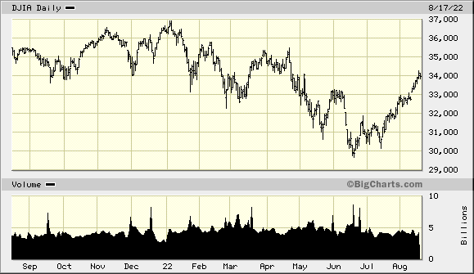
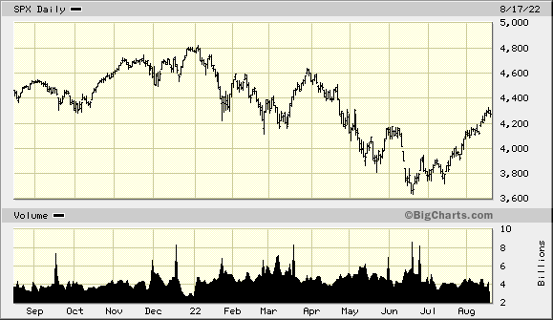
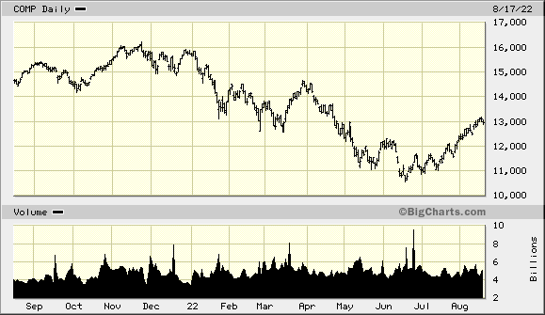
Market update

Slide 3
Investor Sentiment
Bullish Bearish Neutral
AAII 32.2 36.7 27.5
Investor’s Intelligence 45 27.5 27.5

Slide 4
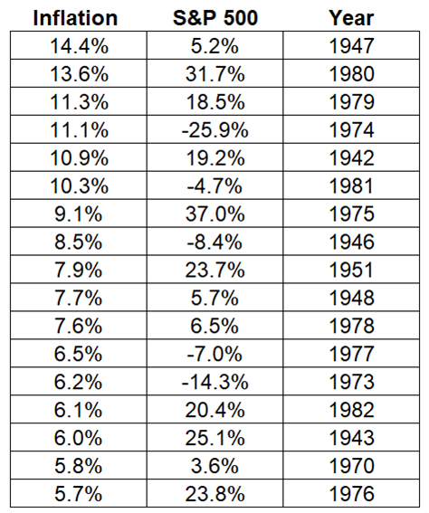
Inflation—It Doesn’t Kill the Market
July: 8.5%, less than the 8.7% expected and down from 9.1%in June
Source: Onebridgewealth.com

Slide 5
CMC Stock of the Month (August Issue)
Spotlight stock:
MP Materials Corp. (MP): Turning “Rare” Minerals into Profits
MP Materials Corp. (MP) 52-Week Low/High: $27.48 – 60.19 Shares Outstanding: 177.53 million Institutionally Owned: 69.78% Market Capitalization: $6.789 Billion Dividend Yield: n/a https://mpmaterials.com | Why MP Materials: Accelerating industry demand Materials are difficult to access One-of-a-kind American company Inflation hedge Undervalued

Slide 6
Why Buy MP?
1. MP is a fundamental way to play clean tech, defense, semiconductors, and other advanced and emerging technologies through some of their basic inputs--rare earths
2. As a real asset commodity, MP is a hedge on inflation
3. MP can be seen as a strategic hedge on rising tensions in Asia and between the U.S. and China with flashpoints in Asia—including Taiwan—since China could disrupt rare earth supplies, sending prices sharply higher.

Slide 7
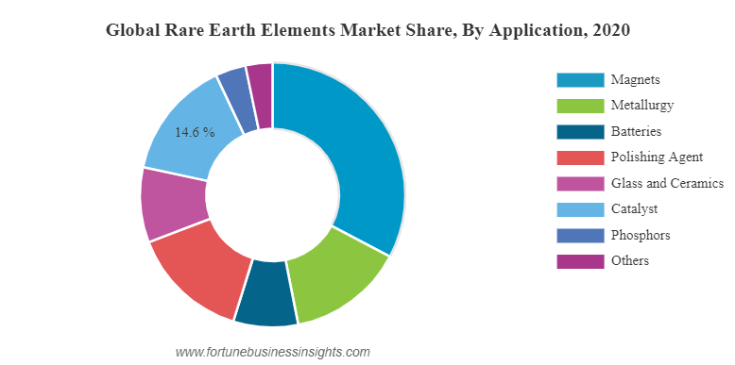
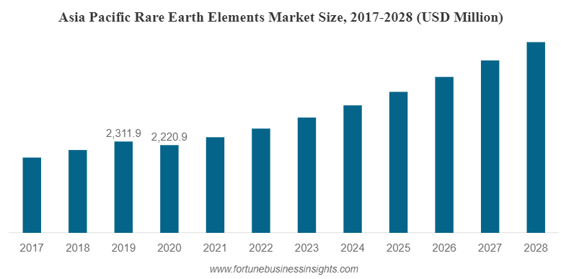
China has the Lead in Rare Earth Elements

Slide 8
Electric Vehicle Demand

Slide 9
CSOM Portfolio
Company | Symbol | Date Bought | Price Bought | Price on 8/17/22 | Dividends YTD | Div Freq. | Gain/ Loss % | Rating
GitLab Inc. | GTLB | 4/13/22 | 49.02 | 65.12 | N/A | N/A | 32.84% | Hold
Invesco Dow Jones Industrial Average Dividend ETF | DJD | 5/13/22 | 44.41 | 44.50 | N/A | N/A | .02% | Buy
M/I Homes, Inc. | MHO | 6/10/22 | 43.75 | 46.54 | N/A | N/A | 6.38% | Buy
MP Materials Corp. | MP | 8/11/22 | 37.81 | 35.89 | N/A | N/A | –5.35% | Buy
QUALCOMM Incorporated (QCOM) | QCOM | 7/15/22 | 143.76 | 148.53 | N/A | N/A | 3.32% | Buy

Slide 10
Cabot ETF Strategies
Portfolio Going Forward
iShares Core S&P 500 (IVV)
iShares US Energy (IYE)
iShares Global Financial (IXG)
iShares TIPS Bond (TIP)
iShares 10-20 Yr Treasury Bond (TLH)
iShares Core US Treasury Bond (GOVT)
iShares J.P. Morgan USD Emerging Markets Bond (EMB)

Slide 11
Portfolio Going Forward
Invesco Dow Jones Industrial Average Dividend ETF (DJD)
AGFiQ US Market Neutral Anti-Beta Fund (BTAL)
ALPS Medical Breakthroughs ETF (SBIO)
Renaissance IPO ETF (IPO)

Slide 12
U.S. Equities – Russell Indexes
Index | ETF | Today | 1 Month | YTD | 1 Year | 3 Years
Large Cap Growth | IWF | -0.78% | 13.76% | -15.75% | -9.42% | 63.12%
Large Cap Value | IWD | -0.87% | 10.35% | -4.04% | -1.27% | 30.83%
Mid Cap Growth | IWP | -1.31% | 16.16% | -18.16% | -17.57% | 33.14%
Mid Cap Value | IWS | -1.10% | 12.70% | -5.43% | -1.44% | 34.75%
Small Cap Growth | IWO | -1.66% | 16.90% | -15.47% | -15.75% | 27.12%
Small Cap Value | IWN | -1.64% | 15.26% | -4.02% | -0.55% | 40.03%

Slide 13
U.S. Sectors
Index | ETF | Today | 1 Month | YTD | 1 Year | 3 Years
Basic Materials | XLB | -1.37% | 13.16% | -10.03% | -5.23% | 43.98%
Communication Services | XLC | -1.94% | 8.09% | -22.90% | -28.13% | 22.88%
Consumer Discretionary | XLY | -1.08% | 19.42% | -15.39% | -4.29% | 49.25%
Consumer Staples | XLP | -0.29% | 5.73% | 0.01% | 5.75% | 28.09%
Energy | XLE | 0.83% | 11.91% | 38.31% | 58.24% | 38.65%
Financial Services | XLF | -0.50% | 12.68% | -8.30% | -6.94% | 34.78%
Healthcare | XLV | -0.58% | 2.86% | -4.94% | -0.95% | 48.87%
Industrial | XLI | -0.80% | 15.76% | -4.99% | -4.58% | 35.30%
Technology | XLK | -0.71% | 14.18% | -13.07% | -2.92% | 93.09%
Utilities | XLU | -0.17% | 11.21% | 8.38% | 12.27% | 26.39%
Real Estate | XLRE | -0.29% | 11.12% | -12.06% | -2.63% | 17.85%

Slide 14
ETF Strategy
GOALS:
Diversification
Growth
Income
Safety
PORTFOLIO RECLASSIFICATION:
1 Portfolio, with Aggressive, Moderate, and Conservative Allocations

Slide 15
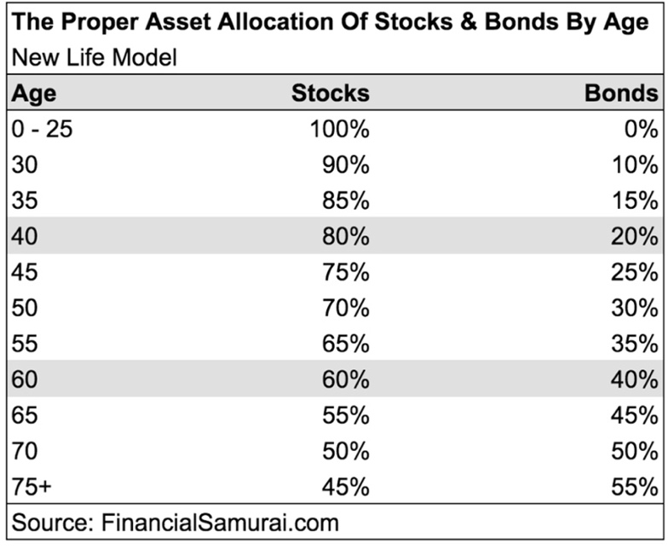
Suggested Portfolio Allocations
According to age:

Slide 16
Risk Aversion
Conservative
As a conservative investor, you are less willing to accept market swings and significant changes in the value of your portfolio in the short- or long-term. Capital preservation is your primary goal, and you may plan on using the principal from your investments in the near-term, preferably as a steady income stream. The average level of return you expect to see is 5%-10%, annually.
Moderate
As a moderate investor, you seek longer-term investment gains. You are comfortable with some swings in your portfolio’s performance, but generally seek to invest in more conservative stocks that build wealth over a substantial period of time. The average level of return you expect to see is 10%-25% annually.
Aggressive
As an aggressive investor, you primarily seek capital appreciation and are open to more risk. Swings in the market, whether short term or long term, do not impact your investment decisions and you have confidence that volatility is necessary to achieve the high return-on-investment you are looking for. You typically expect a 25%+ return, annually, though you do not need your principal investment immediately.

Slide 17
CMC Magazine (August Issue)
The Insurance Deep-Dive: What You Need, What You Don’t and Profiting on Insurance
Why you may need a life insurance policy:
Are married, or plan to wed
Have children, or are planning to become parents
Owe money on student loans
Have excessive debt
Are fully or partially responsible for supporting your aging parents
Are self-employed
Have a high-risk job or dangerous hobbies

Slide 18
Who Doesn’t Need Life Insurance?
People who:
Are retired
Have no dependents
Have plenty of assets that will cover your death costs as well as any debts that will outlive you

Slide 19
Types of Life Insurance
Type of life insurance | Term | Permanent
Term life insurance | ✓
Whole life insurance |  | ✓
Universal life insurance |  | ✓
Variable life insurance |  | ✓
Indexed universal life insurance |  | ✓
Simplified issue life insurance | ✓ | ✓
Guaranteed issue life insurance | ✓ | ✓
Group life insurance | ✓ | ✓

Slide 20
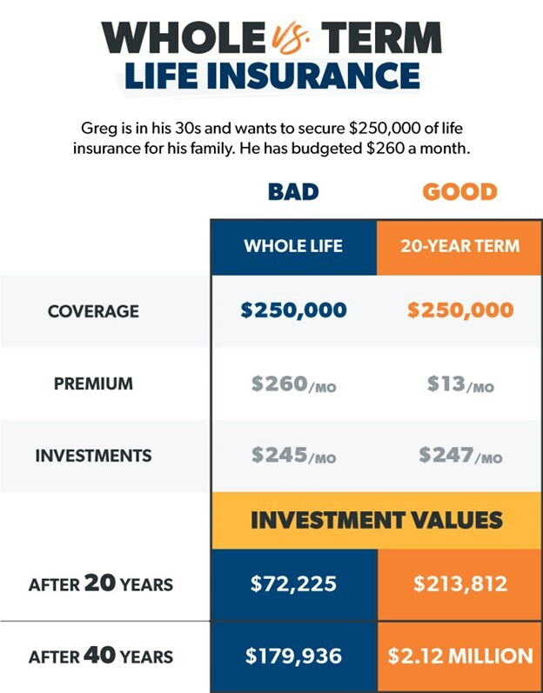
Whole Life vs. Term Life Insurance

Slide 21
Life Insurance Calculators
https://www.bankrate.com/insurance/life-insurance/life-insurance-calculator/
https://www.fidelity.com/calculators-tools/life-insurance
https://www.ramseysolutions.com/insurance/term-life-insurance-calculator

Slide 22
The 10 Best Life Insurance Companies
Insurance company | NerdWallet rating | Term lengths available
Haven Life | ***** | 5, 10, 15, 20, 25 or 30 years.
Guardian Life | ***** | 10, 15, 20 or 30 years.
AARP | ***** | No traditional term lengths — all policies expire at age 80.
Fabric | ***** | 10, 15, 20, 25 or 30 years.
MassMutual | ***** | 1, 10, 15, 20, 25 or 30 years.
New York Life | ****1/2 | 1, 10 or 20 years.
Pacific Life | ****1/2 | 10, 15, 20, 25 or 30 years.
State Farm | ****1/2 | 10, 20 or 30 years.
Lincoln Financial | ****1/2 | 10, 15, 20 or 30 years.
Northwestern Mutual | ****1/2 | 1, 10 or 20 years.
USAA | ****1/2 | 10 to 30 years.

Slide 23
My 3 Favorite Life Insurance Stocks
Company (Symbol) | Price | P/E | Dividend Yield | Ranking
Unum Group (UNM) | $39.33 | 7.22 | 3.35% | Buy
Reinsurance Group of America, Incorporated (RGA) | $128.10 | 32.19 | 2.48% | Buy
Globe Life Inc. (GL) | $103.42 | 14.71 | 0.80% | Buy

Slide 24
Claim your half-price Charter Membership in the Cabot Money Club right now! You’ll get full and instant access to advice about investing in the right stocks to ensure your financial independence and security:
A full subscription to Cabot Money Club Stock of the Month, including Cabot ETF Strategies
A full subscription to Cabot Money Club Magazine
Immediate access to Cabot Money Club Premium Reports
Access to our specially curated Cabot Money Club Investor Briefings
https://cabotwealth.com/webinarspecial

Slide 25
Questions
Please submit questions using the chat feature.
Next Webinar
How to Profit and Protect Your Portfolio in the Age of the U.S.-China Rivalry
Thursday, September 22 at 2:00 PM ET Presenter: Carl Delfeld, Chief Analyst, Cabot Explorer Sign up now at CabotWealth.com/webinars

Slide 26
Contact
Nancy Zambell, Editor-in-Chief Cabot Money Club Support@CabotWealth.com

